Slide 1
West Belfast Area Learning Community working in partnership with the West Belfast Partnership Board – a journey of improvement through collaboration
Notes:
West Belfast Area Learning Community working in partnership with the West Belfast Partnership Board – a journey of improvement through collaboration

Slide 2
Context of Collaboration – a journey from isolation to collaboration – 2007 - 2017
Initially, schools starting working together under duress - through a “forced relationship” incentivised by meagre funding
Many factors were impacting on the schools in the area
Working in “silos” with little knowledge or understanding of each other
Falling enrolments leading to redundancies with schools in danger of closing or amalgamating
Poor standards of achievement across many of the schools
Multiple socio-economic factors
Major policy changes in education which were putting pressure on the system
Notes:
Context of Collaboration – a journey from isolation to collaboration – 2007 - 2017
Initially, schools starting working together under duress - through a “forced relationship” incentivised by meagre funding
Many factors were impacting on the schools in the area
Working in “silos” with little knowledge or understanding of each other
Falling enrolments leading to redundancies with schools in danger of closing or amalgamating
Poor standards of achievement across many of the schools
Multiple socio-economic factors
Major policy changes in education which were putting pressure on the system

Slide 3
Policy changes which were most impacting on schools (1)
Sustainable Schools Policy – All schools would have to be a minimum size – at least 100 pupils in each year group - a major challenge with falling birth rates and enrolments
“The Department is committed to a vision that ensures that every learner fulfils his or her full potential at each stage of development. This means that new opportunities for collaboration and sharing in education should be pursued”
Area Based Planning linked to this policy – Reconfiguration of the schools’ estate – all schools were under threat
Entitlement Framework Policy – All schools would have to offer 24 subjects to pupils at Key Stage 4 (age 15) and 27 subjects at Key Stage 5 (Post 16) – A specific combination of subjects would have to be offered at each key stage - a major challenge as schools would have to change their curriculum and would have to offer access to pupils from other schools

Slide 4
Policy changes which were most impacting on schools (2)
Every School a Good School Policy 2008 – All schools’ performance would be measured rigorously against specific benchmarks
“Our vision is of schools as vibrant, self-improving, well-governed and effectively led communities of good practice, focusing not on institutions but on meeting the needs and aspirations of pupils through high quality learning, recognising the centrality of teaching”
Move towards working as a community of schools vs schools looking after and out for themselves
Notes:
Policy changes which were most impacting on schools (2)
Every School a Good School Policy 2008 – All schools’ performance would be measured rigorously against specific benchmarks
“Our vision is of schools as vibrant, self-improving, well-governed and effectively led communities of good practice, focusing not on institutions but on meeting the needs and aspirations of pupils through high quality learning, recognising the centrality of teaching”
Move towards working as a community of schools vs schools looking after and out for themselves

Slide 5
Context of schools in West Belfast
70% of areas of highest deprivation in North of Ireland are in West Belfast
The areas of social deprivation ranked numbers 1,2 & 3 are in West Belfast
Population @ 94,000 = 5.2% of the population
Child Poverty: 41.1% 0-15yr olds – NI average 22.1% Colin Glen (65.3%), Falls (59.1%) and Shankill (58.3%).
Health: If you live in West Belfast you are likely to die 8 years earlier than a person in a more affluent area of Belfast
Education: 2011- 49% of pupils in West Belfast achieved 5 or more GCSE exams, in 2016 West Belfast ALC schools this has increased to 66.4% - spectacular improvement.
West Belfast has a vibrant, flourishing education network which includes 23 nursery, 17 primary and 10 post primary schools as well as community organisations.
Notes:
Context of schools in West Belfast
70% of areas of highest deprivation in North of Ireland are in West Belfast
The areas of social deprivation ranked numbers 1,2 & 3 are in West Belfast
Population @ 94,000 = 5.2% of the population
Child Poverty: 41.1% 0-15yr olds – NI average 22.1% Colin Glen (65.3%), Falls (59.1%) and Shankill (58.3%).
Health: If you live in West Belfast you are likely to die 8 years earlier than a person in a more affluent area of Belfast
Education: 2011- 49% of pupils in West Belfast achieved 5 or more GCSE exams, in 2016 West Belfast ALC schools this has increased to 66.4% - spectacular improvement.
West Belfast has a vibrant, flourishing education network which includes 23 nursery, 17 primary and 10 post primary schools as well as community organisations.

Slide 6
School statistics
School | Enrolment | Type | % FSME | % SEN | Number with Statement
St Dominic’s Grammar School – Girls | 1034 | Selective | 28.6% | 5.4% | 16
St. Rose’s High School - Girls | 240 | All ability | 71.3% | 44.5% | 10
St. Louise’s Comprehensive College - Girls | 1420 | All ability | 59.6% | 39.2% | 34
Corpus Christi College - Boys | 258 | All ability | 73.3% | 54.6% | 36
Colaiste Feirste – Co-ed Irish Medium | 646 | All ability | 64.7% | 51.8% | 22
Christian Brothers Secondary School - Boys | 500 | All ability | 65.2% | 57.8% | 50
St. Mary’s CBS Grammar School - Boys | 1161 | All ability | 38.5% | 19% | 33
St. Gerard’s School – Co-ed | 232 | Special | 76.3% | 100% | 224 -96.5%
Notes:
School statistics
Table showing school statistics for enrolment number, type of school, % free school meal entitlement (FSME), % SEN, number of learners with a statement.
St Dominic's Grammar School (girls): 1,034 enrolled, selective type, 28.6% FSME, 5.4% SEN, 16 with a statement.
St Rose's High School (girls): 240 enrolled, all ability type, 71.3% FSME, 44.5% SEN, 10 with statement.
St Louise's Comprehensive College (girls): 1,420 enrolled, all ability type, 59.6% FSME, 39.2% SEN, 34 with statement.
Corpus Christi College (boys): 258 enrolled, all ability type, 73.3% FSME, 54.6% SEN, 36 with statement.
Colaiste Feirste (co-ed Irish Medium): 646 enrolled, all ability type, 64.7% FSME, 51.8% SEN, 22 with statement.
Christian Brothers Secondary School (boys): 500 enrolled, all ability type, 65.2% FSME, 57.8% SEN, 50 with statement.
St Mary's CBS Grammar School (boys): 1,161 enrolled, all ability type, 38.5% FSME, 19.0% SEN, 33 with statement.
St Gerard's School (Co-ed): 232 enrolled, special type, 76.3% FSME, 100% SEN, 224 (96.5%) with statement.

Slide 7
Drivers which enabled progress – true collaboration leading to improved pupil outcomes across West Belfast Area (1)
2009 – Area-based inspection in West Belfast – many areas of concern were raised
A number of new agents began attending the West Belfast Area Learning Community – The ETI District Inspector, Dr Shevlin and Ms Angie Mervyn, Education Officer of the West Belfast Partnership Board (umbrella group for numerous community groups) - facilitated through having an effective Chair and Co-ordinator (latter was financed through DE), the Belfast Education and Library Board Advisor for Post-primary
Dr Shevlin focused all the schools on self-evaluation and self-improvement
Angie Mervyn started channelling additional funding for literacy and numeracy into schools
Notes:
Drivers which enabled progress – true collaboration leading to improved pupil outcomes across West Belfast Area (1)
2009 – Area-based inspection in West Belfast – many areas of concern were raised
A number of new agents began attending the West Belfast Area Learning Community – The ETI District Inspector, Dr Shevlin and Ms Angie Mervyn, Education Officer of the West Belfast Partnership Board (umbrella group for numerous community groups) - facilitated through having an effective Chair and Co-ordinator (latter was financed through DE), the Belfast Education and Library Board Advisor for Post-primary
Dr Shevlin focused all the schools on self-evaluation and self-improvement
Angie Mervyn started channelling additional funding for literacy and numeracy into schools

Slide 8
Drivers which enabled progress – true collaboration leading to improved pupil outcomes across West Belfast Area (2)
Attention from outside the area – Dublin City University – West Belfast targeted for Polycentric Area- based improvement research
Schools started building trusting relationships through working together to identify areas which required improvement across all schools and setting up self-improvement sub groups/teams
CEAIG – Careers team
ICT team
Pastoral team
Numeracy team
SEN Team
Vice-principals’ team
Notes:
Drivers which enabled progress – true collaboration leading to improved pupil outcomes across West Belfast Area (2)
Attention from outside the area – Dublin City University – West Belfast targeted for Polycentric Area- based improvement research
Schools started building trusting relationships through working together to identify areas which required improvement across all schools and setting up self-improvement sub groups/teams
CEAIG – Careers team
ICT team
Pastoral team
Numeracy team
SEN Team
Vice-principals’ team

Slide 9
Drivers which enabled progress – true collaboration leading to improved pupil outcomes across West Belfast Area – Practical activities arising from these
Maths HoDs began meeting each other to share best practice and to visit schools where best practice was happening
Additional resources in schools to promote Saturday Schools, after-schools’ support for pupils struggling with Maths and English
Access to courses which met the needs and aspirations of pupils – schools which could offer additional courses supported schools which couldn’t offer a broad curriculum to their pupils
Performance Data was collated from across the schools and schools started taking pride in the performance of the area vs focusing solely on their own data – performance rose beyond expectation
Careers Conference is arranged annually for pupils from all schools
Joint training in leadership
Sharing of best practice across all sub groups
Notes:
Drivers which enabled progress – true collaboration leading to improved pupil outcomes across West Belfast Area – Practical activities arising from these
Maths HoDs began meeting each other to share best practice and to visit schools where best practice was happening
Additional resources in schools to promote Saturday Schools, after-schools’ support for pupils struggling with Maths and English
Access to courses which met the needs and aspirations of pupils – schools which could offer additional courses supported schools which couldn’t offer a broad curriculum to their pupils
Performance Data was collated from across the schools and schools started taking pride in the performance of the area vs focusing solely on their own data – performance rose beyond expectation
Careers Conference is arranged annually for pupils from all schools
Joint training in leadership
Sharing of best practice across all sub groups

Slide 10
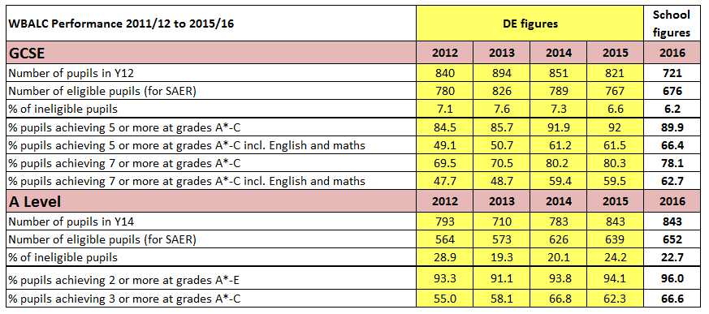
Performance – All Pupils
GCSE Results | 2015 – 2016 % increase | 2011 – 2016 % increase
5 or more Grades A* - C including Maths & English | 4.9% | 17.4%
7 or more Grades A* - C including Maths & English | 2.2% | 15%
A Level Results | 2015 – 2016 % increase | 2011 – 2016 % increase
2 or more Grades A* - E | 1.9% | 6.1%
3 or more Grades A* - C | 4.3% | 15.5%
Notes:
Performance – All Pupils
Table showing the WBALC Performance 2011/12 to 2015/16. The figures for 2012-2015 are DE figures, the figures for 2016 are school figures.
GCSE
Number of pupils in Y12 - 2012: 840, 2013: 894, 2014: 851, 2015: 821, 2016: 721.
Number of eligible pupils (for SAER) - 2012: 780, 2013: 826, 2014: 789, 2015: 767, 2016: 676.
% of ineligible pupils - 2012: 7.1, 2013: 7.6, 2014: 7.3, 2015: 6.6, 2016: 6.2.
% pupils achieving 5 or more at grades A*-C - 2012: 84.5, 2013: 85.7, 2014: 91.9, 2015: 92, 2016: 89.9.
% pupils achieving 5 or more at grades A*-C incl. English and maths - 2012: 49.1, 2013: 50.7, 2014: 61.2, 2015: 61.5, 2016: 66.4.
% pupils achieving 7 or more at grades A*-C - 2012: 69.5, 2013: 70.5, 2014: 80.2, 2015: 80.3, 2016: 78.1.
% pupils achieving 7 or more at grades A*-C incl. English and maths - 2012: 47.7, 2013: 48.7, 2014: 59.4, 2015: 59.5, 2016: 62.7.
A Level
Number of pupils in Y14 - 2012: 793, 2013: 710, 2014: 783, 2015: 843, 2016: 843.
Number of eligible pupils (for SAER) - 2012: 564, 2013: 573, 2014: 626, 2015: 639, 2016: 652.
% of ineligible pupils - 2012: 28.9, 2013: 19.3, 2014: 20.1, 2015: 24.2, 2016: 22.7.
% pupils achieving 2 or more at grades A*-E - 2012: 93.3, 2013: 91.1, 2014: 93.8, 2015: 94.1, 2016: 96.0.
% pupils achieving 3 or more at grades A*-C - 2012: 55.0, 2013: 58.1, 2014: 66.8, 2015: 62.3, 2016: 66.6.
Table showing the GCSE results % increase.
5 or more grades A*-C including maths and English - 2015-2016 % increase: 4.9%, 2011-2016 % increase: 17.4%.
7 or more grades A*-C including maths and English - 2015-2016 % increase: 2.2%, 2011-2016 % increase: 15.0%.
Table showing the A level results % increase.
2 or more grades A*-E - 2015-2016 % increase: 1.9%, 2011-2016 % increase: 6.1%.
3 or more grades A*-C - 2015-2016 % increase: 4.3%, 2011-2016 % increase: 15.5%.

Slide 11
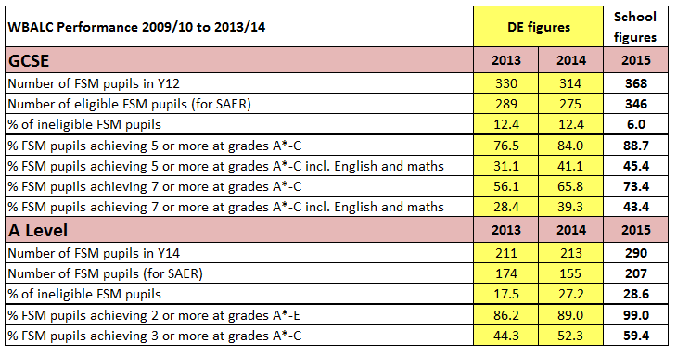
Free School Meal Pupils
Notes:
Free School Meal Pupils
Table showing the WBALC Performance 2013 to 2015. The figures for 2013 and 2014 are DE figures, the figures for 2015 are school figures.
GCSE
Number of FSM pupils in Y12 - 2013: 330, 2014: 314, 2015: 368.
Number of eligible FSM pupils (for SAER) - 2013: 289, 2014: 275, 2015: 346.
% of ineligible FSM pupils - 2013: 12.4, 2014: 12.4, 2015: 6.0.
% FSM pupils achieving 5 or more at grades A*-C - 2013: 76.5, 2014: 84.0, 2015: 88.7.
% FSM pupils achieving 5 or more at grades A*-C incl. English and maths - 2013: 31.1, 2014: 41.1, 2015: 45.4.
% FSM pupils achieving 7 or more at grades A*-C - 2013: 56.1, 2014: 65.8, 2015: 73.4.
% FSM pupils achieving 7 or more at grades A*-C incl. English and maths - 2013: 28.4, 2014: 39.3, 2015: 43.4.
A Level
Number of FSM pupils in Y14 - 2013: 211, 2014: 213, 2015: 290.
Number of eligible FSM pupils (for SAER) - 2013: 174, 2014: 155, 2015: 207.
% of ineligible FSM pupils - 2013: 17.5, 2014: 27.2, 2015: 28.6.
% FSM pupils achieving 2 or more at grades A*-E - 2013: 86.2, 2014: 89.0, 2015: 99.0.
% FSM pupils achieving 3 or more at grades A*-C - 2013: 44.3, 2014: 52.3, 2015: 59.4.

Slide 12
Next Practice vs Best Practice
Primary schools started replicating the work of post-primary group and in turn the nursery schools started doing likewise
Primary Transition programme- bridging units planned for last year in primary school and first year in post-primary. Through working together and delivering a joint programme, the primary and post-primary schools are gaining a better understanding of each other’s curriculum
Cross-phase sharing of best practice including classroom observation and assessment practices
Notes:
Next Practice vs Best Practice
Primary schools started replicating the work of post-primary group and in turn the nursery schools started doing likewise
Primary Transition programme- bridging units planned for last year in primary school and first year in post-primary. Through working together and delivering a joint programme, the primary and post-primary schools are gaining a better understanding of each other’s curriculum
Cross-phase sharing of best practice including classroom observation and assessment practices

