Slide 1
Closing the Gap: Strategies
Notes:
Closing the Gap: Strategies

Slide 2
National 5 Laboratory Science
Calderglen High School
Nov 2016
Notes:
National 5 Laboratory Science
Calderglen High School
Nov 2016

Slide 3
Why N5 Laboratory Science?
For S5/6 pupils taking National 5 awards, the results in typical discrete science courses showed these did not suit the needs of many learners
The school leadership team used data to identify this gap in the curriculum
Staff identified more practical accredited courses as alternatives to engage pupils through partnership working, development of skills and career relevance.
Notes:
Why N5 Laboratory Science?
For S5/6 pupils taking National 5 awards, the results in typical discrete science courses showed these did not suit the needs of many learners
The school leadership team used data to identify this gap in the curriculum
Staff identified more practical accredited courses as alternatives to engage pupils through partnership working, development of skills and career relevance.

Slide 4
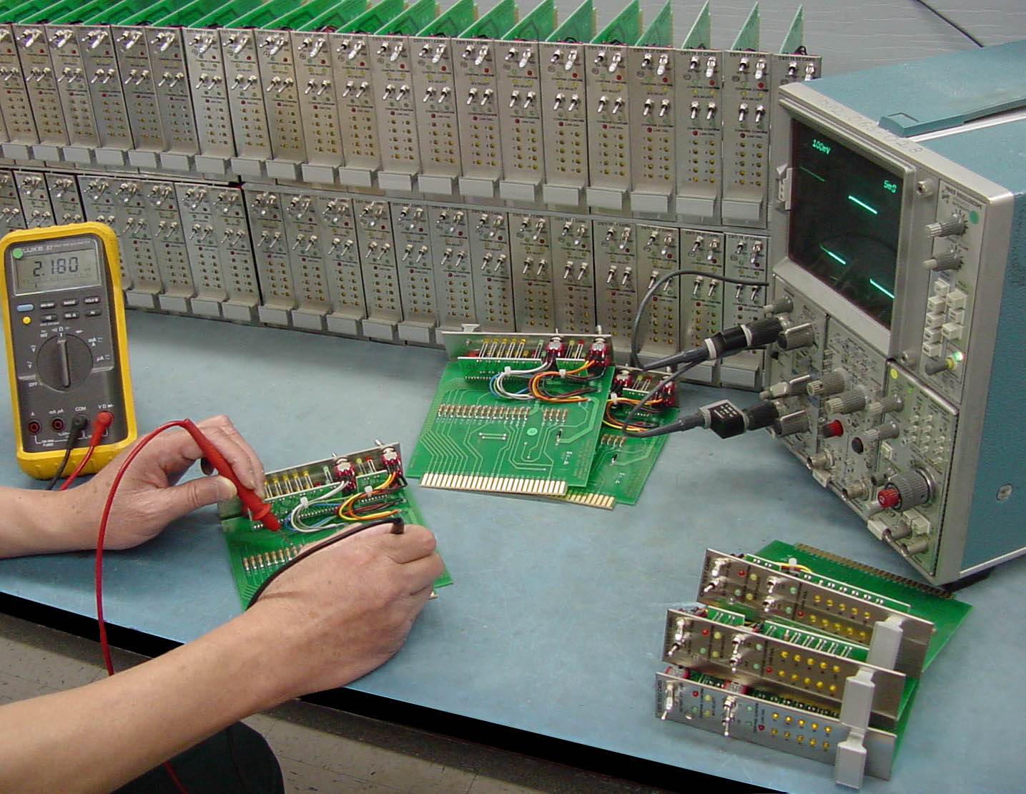
Alternative Course Provision
S5 Laboratory Science
Practical Electronics
N4 Science / John Muir
Notes:
Alternative Course Provision
S5 Laboratory Science
Practical Electronics
N4 Science / John Muir

Slide 5
Partners
Research - partner schools
local authority
nationally
Funding
SQA accreditation
Notes:
Partners
Research - partner schools
local authority
nationally
Funding
SQA accreditation

Slide 6
Course Rationale
SQA accredited course.
broad “hands on” introduction to laboratory science.
laboratories career opportunities, locally, nationally, and globally.
Notes:
Course Rationale
SQA accredited course.
broad “hands on” introduction to laboratory science.
laboratories career opportunities, locally, nationally, and globally.

Slide 7
Transferable skills
Measuring, weighing and preparing compounds and solutions for laboratory use
Communication
Health and safety
Problem solving and numeracy skills
Improve employment potential within a sector
Awareness of strengths and weaknesses
Reflect on how this affects their employability potential.
Notes:
Transferable skills
Measuring, weighing and preparing compounds and solutions for laboratory use
Communication
Health and safety
Problem solving and numeracy skills
Improve employment potential within a sector
Awareness of strengths and weaknesses
Reflect on how this affects their employability potential.

Slide 8
Four units
Careers using Laboratory Science
Working in a Laboratory
Practical Skills
Practical Investigation
Notes:
Four units
Careers using Laboratory Science
Working in a Laboratory
Practical Skills
Practical Investigation

Slide 9
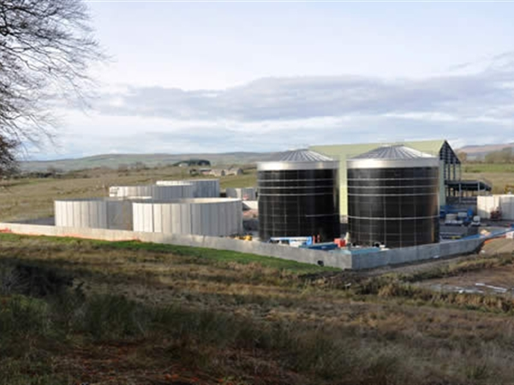
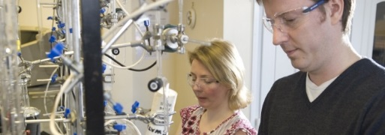
Engage pupils through partnership working, development of skills and career relevance.
Notes:
Engage pupils through partnership working, development of skills and career relevance.

Slide 10
National 5 Laboratory Science class photo
Notes:
National 5 Laboratory Science class photo

