Slide 1



Calderglen High School, Scotland, April 2017
Notes:
Calderglen High School, Scotland, April 2017
Introductory video by Calderglen High School

Slide 2
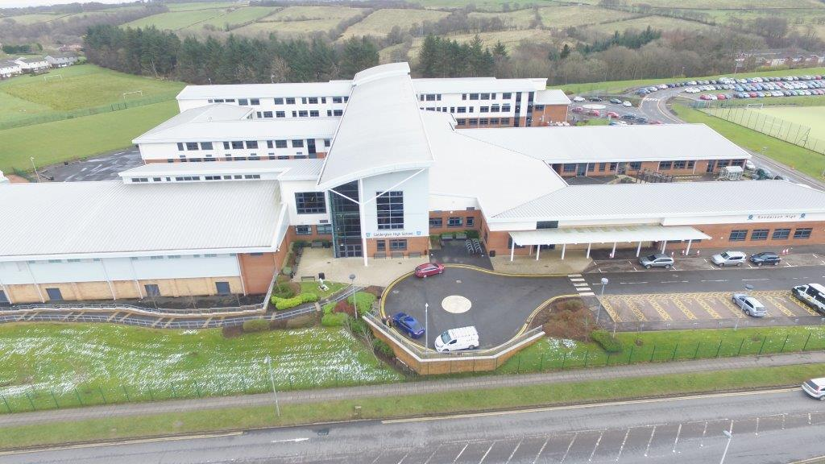
Calderglen High School’s Journey
Notes:
Calderglen High School’s Journey

Slide 3
School Context
2 schools merged in 2007 to form 1 big school of 1,860 pupils
Current school roll is 1,460
Campus school with Sanderson High –for 100 pupils with moderate to severe needs
182 pupils with additional support needs including ASD, dyslexia, ADHD and other learning issues.
An increasing number of pupils with social, emotional and behavioural needs…
Notes:
School Context
2 schools merged in 2007 to form 1 big school of 1,860 pupils
Current school roll is 1,460
Campus school with Sanderson High –for 100 pupils with moderate to severe needs
182 pupils with additional support needs including ASD, dyslexia, ADHD and other learning issues.
An increasing number of pupils with social, emotional and behavioural needs…

Slide 4
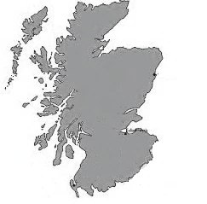
National Context
2010–2016: Year-on-year change in Scottish Education system
Focus on covering/embedding outcomes rather than pedagogical practices
New National Qualifications – new courses and assessments at every stage
Increasing awareness of impact of deprivation on attainment and achievement
Notes:
National Context
2010–2016: Year-on-year change in Scottish Education system
Focus on covering/embedding outcomes rather than pedagogical practices
New National Qualifications – new courses and assessments at every stage
Increasing awareness of impact of deprivation on attainment and achievement

Slide 5
Challenges at outset of this project
Address innovation fatigue in staff to be able to meet the needs of all pupils and continue to provide a highly innovative and engaging curriculum
Examine which pedagogical approaches, new or current, are raising achievement
Close the attainment gap for most disadvantaged pupils and those likely to disengage
Notes:
Challenges at outset of this project
Address innovation fatigue in staff to be able to meet the needs of all pupils and continue to provide a highly innovative and engaging curriculum
Examine which pedagogical approaches, new or current, are raising achievement
Close the attainment gap for most disadvantaged pupils and those likely to disengage

Slide 6
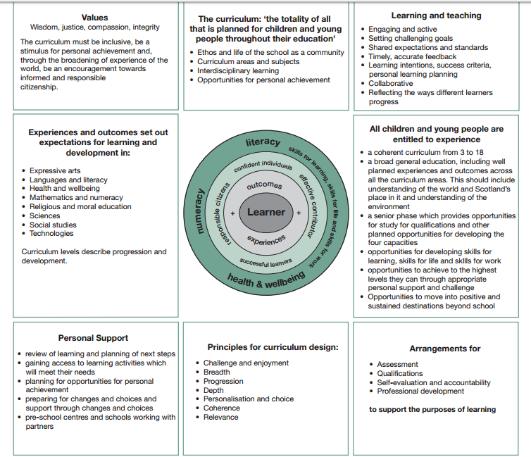
National Supports
Curriculum for Excellence
Flexibility to schools, bespoke provision
Holistic development of the child
Child at the centre
Notes:
National Supports
Curriculum for Excellence
Flexibility to schools, bespoke provision
Holistic development of the child
Child at the centre
[A central circle represents the learner, inside a circle representing outcomes and experiences. Another circle encloses them, representing confident individuals, effective contributor, successful learners and responsible citizens. An outer circle represents literacy. skills for learning, skills for life and skills for work, numeracy and health and wellbeing. Around the edge of the circles are text boxes as follows:
The curriculum: 'the totality of all that is planned for children and young people throughout their education'. Ethos and life of the school as a community; Curriculum areas and subjects; Interdisciplinary learning; Opportunities for personal achievement.
Values: Wisdom, justice, compassion, integrity. The curriculum must be inclusive, be a stimulus for personal achievement and, through the broadening of experience of the world, be an encouragement towards informed and responsible citizenship.
Learning and teaching: Engaging and active; Setting challenging goals; Shared expectations and standards; Timely, accurate feedback; Learning intentions, success criteria, personal learning planning; Collaborative; Reflecting the ways different learners progress.
Experiences and outcomes set out expectations for learning and development in: Expressive arts; Languages and literacy; Health and wellbeing; Mathematics and numeracy; Religious and moral education; Sciences; Social studies; Technologies. Curriculum levels describe progression and development.
All children and young people are entitled to experience: A coherent curriculum from 3 to 18; A broad general education, including well planned experiences and outcomes across all the curriculum areas. This should include understanding of the world and Scotland's place in it and understanding of the environment; A senior phase which provides opportunities for study for qualifications and other planned opportunities for developing the four capacities; Opportunities for developing skills for learning, skills for life and skills for work; Opportunities to achieve to the highest levels they can through appropriate personal support and challenge; Opportunities to move into positive and sustained destinations beyond school.
Personal support: Review of learning and planning of next steps; Gaining access to learning activities which will meet their needs; Planning for opportunities for personal achievement; Preparing for changes and choices and support through changes and choices; Pre-school centres and schools working with partners.
Principles for curriculum design: Challenge and enjoyment; Breadth; Progression; Depth; Personalisation and choice; Coherence; Relevance.
Arrangements for: Assessment; Qualifications; Self-evaluation and accountability; Professional development, to support the purposes of learning.]

Slide 7
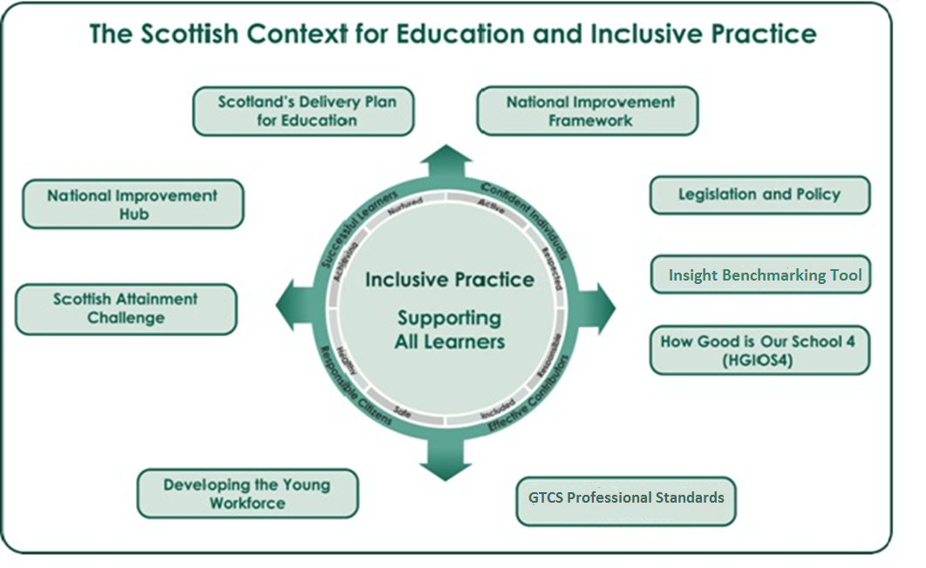
The Scottish Context for Education and Inclusive Practice
Notes:
The Scottish Context for Education and Inclusive Practice
The Calderglen School logo is in the centre of a circle, surrounded by the words Successful learners, Confident individuals, Responsible citizens and Effective contributors. Outside the circle are arrows pointing to national tools and programmes: Scotland's Delivery Plan for Education; National Improvement Framework; National Improvement Hub; Scottish Attainment Challenge; Legislation and Policy; Insight Benchmarking Tool; How Good is Our School 4 (HGIOS4); Developing the Young Workforce; GTCS Professional Standards.

Slide 8

So what have we learned?
Notes:
So what have we learned?

Slide 9
Consider your culture – is it an RA4A culture?
Vision & Values
Strategic & Operational references to Raising Achievement for All (RA4A) which are:
  Clear
  Constant
  Strong
  Permeating
  Acted on – Policy in Action
Notes:
Consider your culture – is it an RA4A culture?
Vision & Values
Strategic & Operational references to Raising Achievement for All (RA4A) which are:
Clear
Constant
Strong
Permeating
Acted on – Policy in Action
Our values of inclusion and achievement – but we need to ensure that it was not just a case of transmitting these values but through being lived and modelled by key leaders – that they were then seen and felt within the organisation and were very much actively applied.
We thought we were very inclusive but learned we learned how much more inclusive we could be.
We also leaned how inclusion per se is not enough and could be seen as tokenism. You may be highly inclusive but don’t raise the achievement of all learners.

Slide 10
What did this lead to?
Gradual but noticeable change of mindset in staff and pupils
Increasing examples of staff automatically beginning to look through a more inclusive lens
A focus on outcomes to ensure achievement for all
Staff engaging in opportunities to gain knowledge and skills to identify and remove barriers to ensure equity for all
Notes:
What did this lead to?
Gradual but noticeable change of mindset in staff and pupils
Increasing examples of staff automatically beginning to look through a more inclusive lens
A focus on outcomes to ensure achievement for all
Staff engaging in opportunities to gain knowledge and skills to identify and remove barriers to ensure equity for all
It’s important that we talked RA4A and acted RA4A – leaders modelling this priority.
Teachers make the difference to inclusiveness, not policy makers.

Slide 11
Working Groups: Meeting learners’ needs
Watch the video on meeting learners’ needs
Notes:
Working Groups: Meeting learners’ needs
Watch the video on meeting learners’ needs
https://www.youtube.com/watch?v=N-f0Vk2SJgU

Slide 12
So what else have we learned? (1)
Notes:
So what else have we learned? (1)

Slide 13
RA4A-proof your systems
Priorities & Improvement Planning
Curriculum Organisation & Design
Self-Evaluation – Outcome-focused
Notes:
RA4A-proof your systems
Priorities & Improvement Planning
Curriculum Organisation & Design
Self-Evaluation – Outcome-focused
Know your impact
Ensuring that through strategic leadership our main improvement agenda includes clear references to raising achievement for all and not simply ensuring inclusion
Is our curriculum fit for purpose – we had to RA4A-proof the curriculum. The balance of academic and vocational. The previous academic curriculum was failing many pupils so we had to move to address this

Slide 14
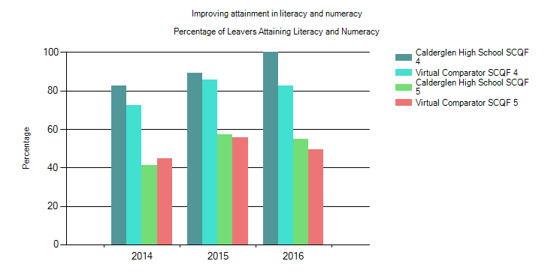
Improving attainment in literacy and numeracy
Percentage of leavers attaining literacy and numeracy
Notes:
Improving attainment in literacy and numeracy
Percentage of leavers attaining literacy and numeracy
The graph shows examination results in literacy and numeracy from 2014-2016 at levels 4 and 5 of the Scottish Qualification Framework. The results show that Calderglen results have increased each year at level 4 and at level 5 have increased from 2014 to 2015 with a small drop in 2016. The graph shows the school results are well above the virtual comparator (made up of pupils from schools in other local authorities who have similar characteristics to the pupils in Calderglen). Virtual comparator results showed a drop at levels 4 and 5 in 2016.

Slide 15
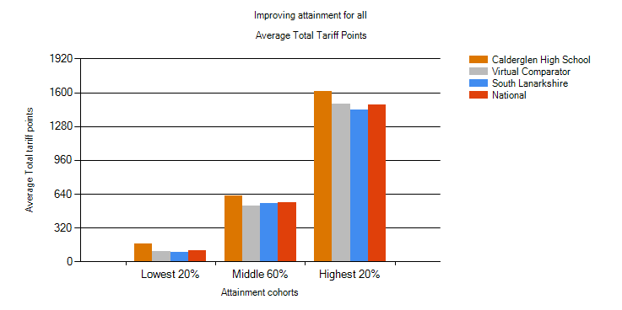
Improving attainment for all
Average total tariff points
Notes:
Improving attainment for all
Average total tariff points
The graph shows increases in average total tariff points for 3 different attainment groups – lowest, middle highest.
Tariff points are awarded according to the level of each qualification, course or unit (accredited to the Scottish Credit and Qualifications Framework) and the grade achieved.
The graph shows that learners at Calderglen in each attainment groups outperformed other schools in the local authority, the virtual comparator and other schools nationally.

Slide 16
So what else have we learned? (2)
Notes:
So what else have we learned? (2)

Slide 17
RA4A-proof your human resources
Equip, Empower & Collaborate:
Teachers
Pupils
Parents
Partners
Let them all lead
Notes:
RA4A-proof your human resources
Equip, Empower & Collaborate:
Teachers
Pupils
Parents
Partners
Let them all lead
Active participation of all
Stronger engagement of all and increase numbers leading the way.

Slide 18
Meeting needs from a parent’s perspective
Watch the video on meeting needs from a parent’s perspective
Notes:
Meeting needs from a parent’s perspective
Watch the video on meeting needs from a parent’s perspective
https://www.youtube.com/watch?v=9seBPzKiRSc
How can you include someone who is not involved in the conversation

Slide 19
Teacher training: Supporting children with Autistic Spectrum Disorder (ASD)
Watch the video on teacher training
Notes:
Teacher training: Supporting children with Autistic Spectrum Disorder (ASD)
Watch the video on teacher training
http://www.european-agency.org/sites/default/files/16.%20Teacher%20training%20%28Scottish%20LC%29.mp4

Slide 20
So what else have we learned? (3)
Notes:
So what else have we learned? (3)

Slide 21
RA4A-proof your decision-making
Curriculum organisation & design
Timetable
Equipment
Budgets
Staffing appointments
Notes:
RA4A-proof your decision-making
Curriculum organisation & design
Timetable
Equipment
Budgets
Staffing appointments

Slide 22
Working Groups: Meeting learners’ needs through the curriculum
Watch the video on meeting learners’ needs through the curriculum
Notes:
Working Groups: Meeting learners’ needs through the curriculum
Watch the video on meeting learners’ needs through the curriculum
https://www.youtube.com/watch?v=sddyTE-mI8M&list=PLWKpdDXcn5-5nf715yXXULP11vNQig8M3&index=6

Slide 23
So what else have we learned? (4)
Notes:
So what else have we learned? (4)

Slide 24
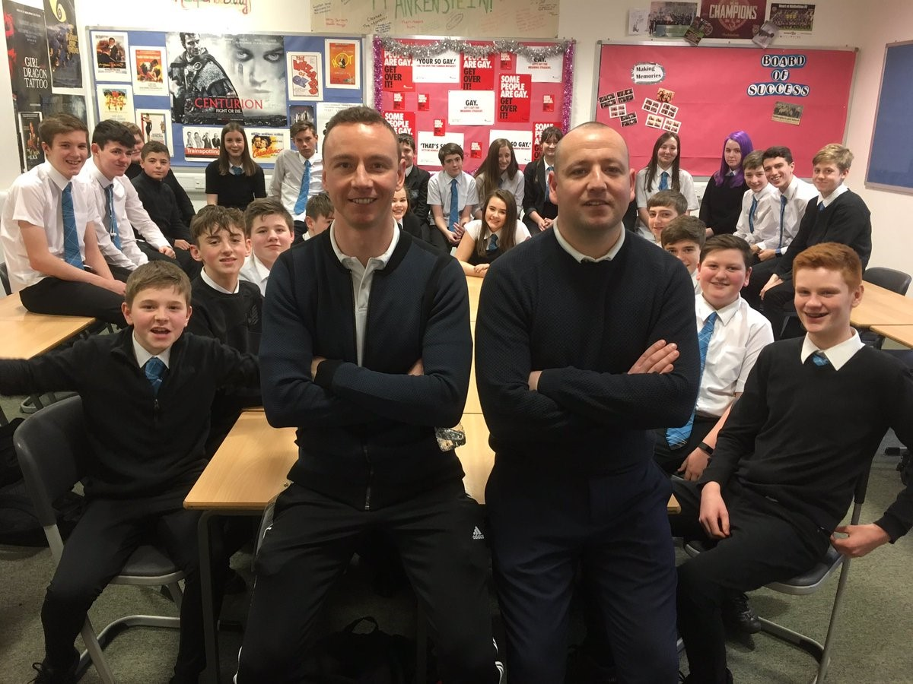
RA4A-proof your thinking
Flexibility
Thinking out the box
Bespoke solutions
Extending & increasing partnerships
Collaborate Collaborate Collaborate…
Partnership working to improve literacy
Notes:
RA4A-proof your thinking
Flexibility
Thinking out the box
Bespoke solutions
Extending & increasing partnerships
Collaborate Collaborate Collaborate…
Partnership working to improve literacy

Slide 25
So what else have we learned? (5)
Notes:
So what else have we learned? (5)

Slide 26
RA4A-proof your professional training
Initial teacher training
Newly Qualified Teachers
Responsibility of All Teachers
New Teachers to your school
Parents & Partners
Equipping all for better RA4A outcomes
Notes:
RA4A-proof your professional training
Initial teacher training
Newly Qualified Teachers
Responsibility of All Teachers
New Teachers to your school
Parents & Partners
Equipping all for better RA4A outcomes
Whole school community needs to have a shared understanding and expectations of inclusive practice.

Slide 27
So what else have we learned? (6)
Notes:
So what else have we learned? (6)

Slide 28
RA4A-proof learning experiences
Keep barriers down
Look for emerging barriers
Flexible solutions are a must
Digital solutions are increasing
Innovative approaches engage staff and pupils well
What in the curriculum is working?
Notes:
RA4A-proof learning experiences
Keep barriers down
Look for emerging barriers
Flexible solutions are a must
Digital solutions are increasing
Innovative approaches engage staff and pupils well
What in the curriculum is working?
Equity is not about treating everyone the same, but recognising the differences and putting in strategies to overcome the barriers – look for emerging barriers – “Everything works under some conditions – nothing works always” Dylan Williams
Teaching approaches – Growth mindset – power of yet

Slide 29
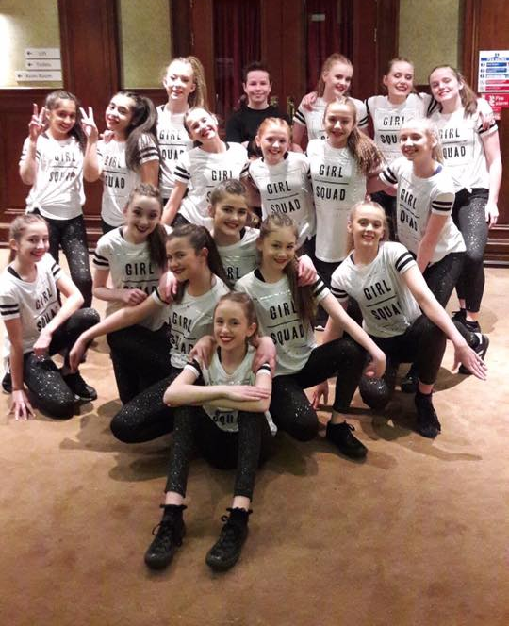
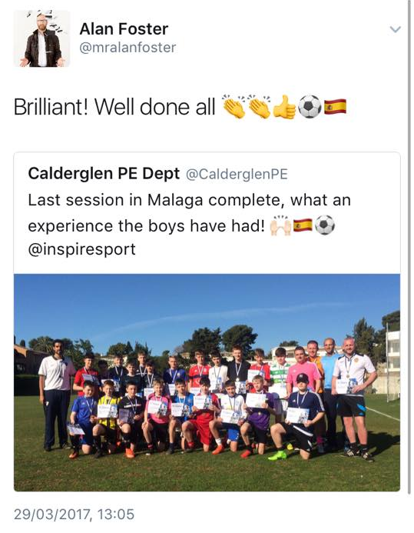
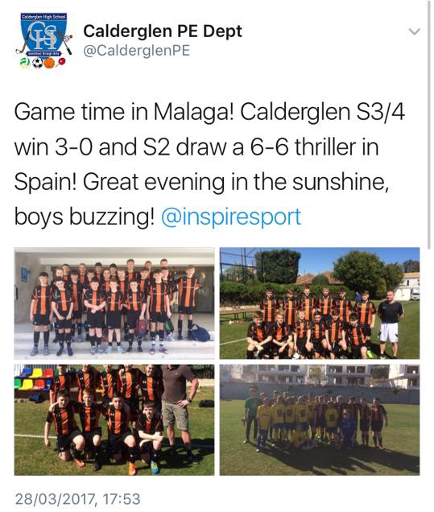
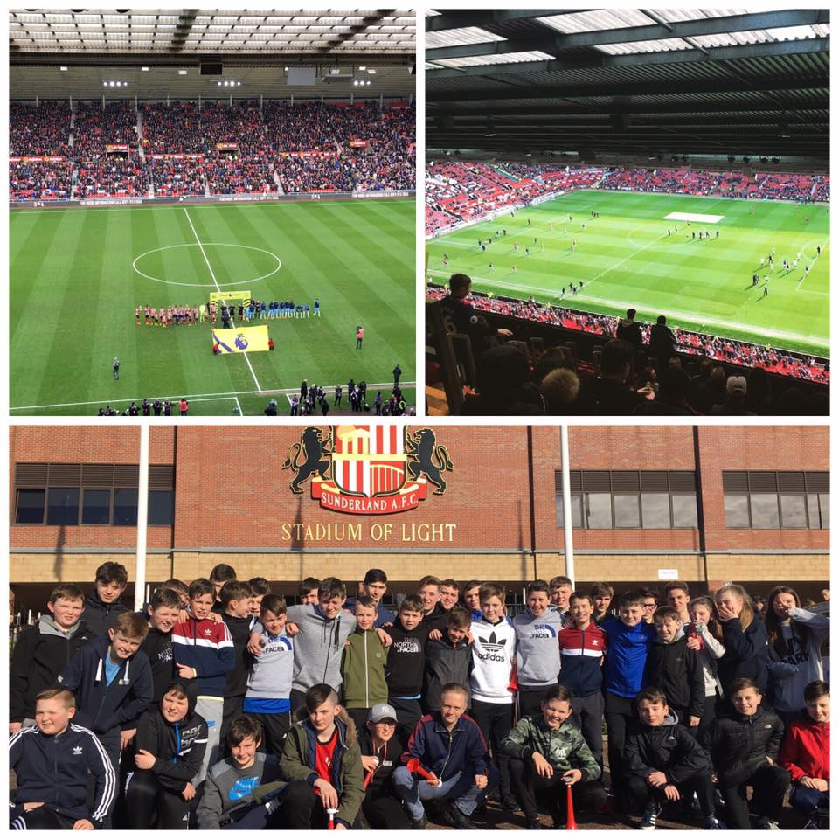
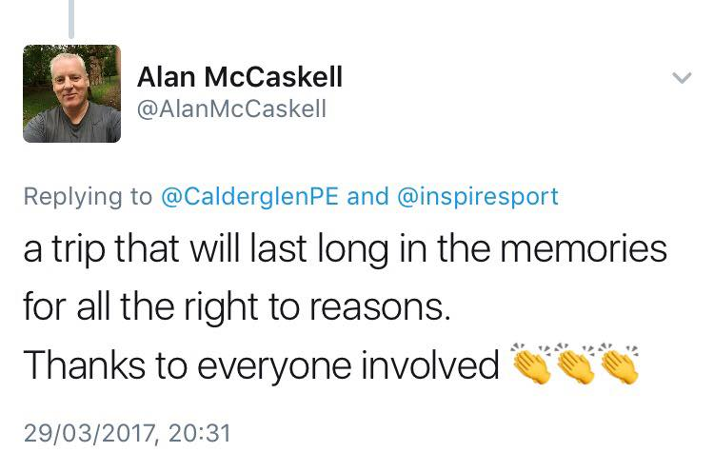
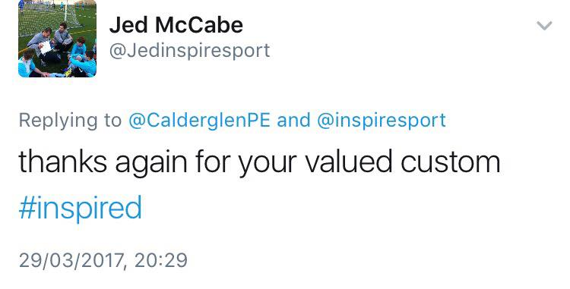

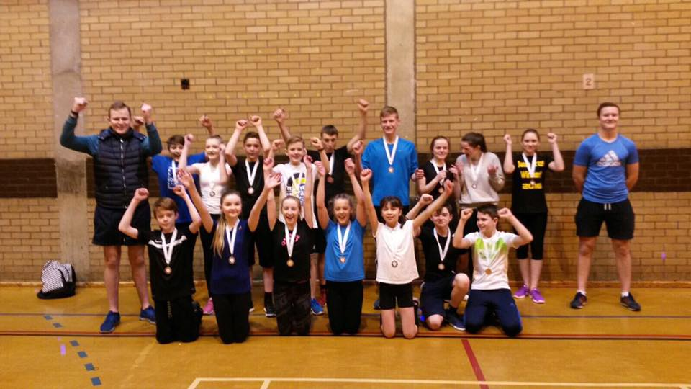
Digital Solutions – Impact of Social Media
Sharing Success
Celebrating Achievement
Promoting a Positive Ethos
Interacting with Parents and Partners
Notes:
Digital Solutions – Impact of Social Media
Sharing Success
Celebrating Achievement
Promoting a Positive Ethos
Interacting with Parents and Partners
Tweet from @Jedinspiresport: Thanks again for your valued custom #inspired
Tweet from @AlanMcCaskell: A trip that will last long in the memories for all the right reasons. Thanks to everyone involved.

Slide 30
Developing a Growth Mindset
Watch the video on Developing a Growth Mindset
Notes:
Developing a Growth Mindset
Watch the video on Developing a Growth Mindset
https://www.youtube.com/watch?v=dotgjFTljvs&index=7&list=PLWKpdDXcn5-5nf715yXXULP11vNQig8M3

Slide 31
What teaching approaches are supporting RA4A?
Watch the video on adopting a growth mindset
Notes:
What teaching approaches are supporting RA4A?
Watch the video on adopting a growth mindset
https://www.youtube.com/watch?v=Z1HQadaWYSw&list=PLWKpdDXcn5-5nf715yXXULP11vNQig8M3&index=8

Slide 32
Are we there yet?
No – so what now?
Notes:
Are we there yet?
No – so what now?

Slide 33
What next?
Spotlight on pupils with emotional and behavioural needs, particularly with regards to attendance and participation
Teachers engaging more with research and professional reading through the RAFORA
Increased use of digital solutions to RA4A
Working cross-sectorally to engage disengaged parents early
Building growth mindset capacity across the learning community and with pupils and parents to develop resilience and emotional literacy
Notes:
What next?
Spotlight on pupils with emotional and behavioural needs, particularly with regards to attendance and participation
Teachers engaging more with research and professional reading through the RAFORA
Increased use of digital solutions to RA4A
Working cross-sectorally to engage disengaged parents early
Building growth mindset capacity across the learning community and with pupils and parents to develop resilience and emotional literacy

Slide 34

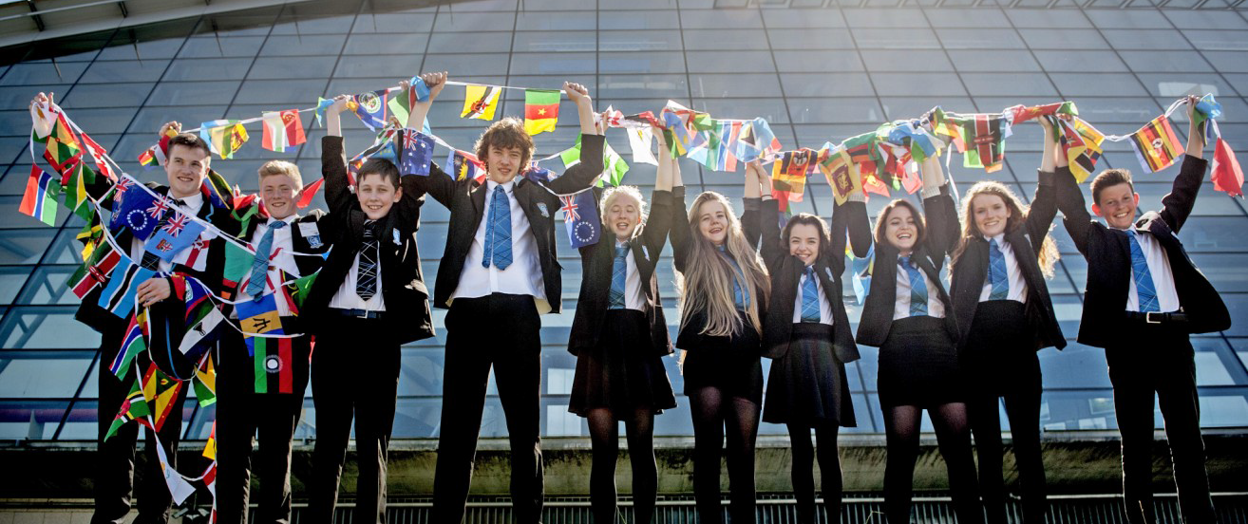
“We are Calderglen” “S e sinne Glinn Challdair”
Confident, Responsible, Contributing, Successful Learners
Notes:
“We are Calderglen” “S e sinne Glinn Challdair”
Confident, Responsible, Contributing, Successful Learners

