Slide 1


RAISING THE ACHIEVEMENT OF ALL LEARNERS IN INCLUSIVE EDUCATION
27-28 SEPTEMBER 2016, FRANKFURT
Notes:
RAISING THE ACHIEVEMENT OF ALL LEARNERS IN INCLUSIVE EDUCATION
27-28 SEPTEMBER 2016, FRANKFURT

Slide 2

PTOF: PIANO TRIENNALE DELL’OFFERTA FORMATIVA
Taking in account the results of the Institute assessment report (RAV), the PTOF (three-year plan for the educational offer) contains guidelines that, over the three years, must direct education, organisational and management of the school.
Notes:
PTOF: PIANO TRIENNALE DELL’OFFERTA FORMATIVA
Taking in account the results of the Institute assessment report (RAV), the PTOF (three-year plan for the educational offer) contains guidelines that, over the three years, must direct education, organisational and management of the school.

Slide 3

Starting from weaknesses that have emerged, the following priorities were defined:
Improvement of results in national standardized tests (INVALSI)
Improving relationships with families
Notes:
Starting from weaknesses that have emerged, the following priorities were defined:
- Improvement of results in national standardized tests (INVALSI)
- Improving relationships with families

Slide 4
Several initiatives have been planned in order to achieve these goals:
meetings with referees for INVALSI to explain to students, teachers and families the aims and the importance of these tests;
Italian and mathematics departments are preparing exercises and simulations in all second class;
afternoon meetings with families to illustrate the PTOF and to involve them more in school life.
Notes:
Several initiatives have been planned in order to achieve these goals:
meetings with referees for INVALSI to explain to students, teachers and families the aims and the importance of these tests;
Italian and mathematics departments are preparing exercises and simulations in all second class;
afternoon meetings with families to illustrate the PTOF and to involve them more in school life.

Slide 5
What did we learn from this project?
Teachers/school staff (1)
The participation to this project facilitated a few but methodical changes in the organization of the working staff. Since last year we are trying to:
Promote the collaboration between support and curricular teachers with formal and informal meetings (training courses, projects)
Change the management of the support teachers working group
Notes:
What did we learn from this project?
Teachers/school staff (1)
The participation to this project facilitated a few but methodical changes in the organization of the working staff. Since last year we are trying to:
Promote the collaboration between support and curricular teachers with formal and informal meetings (training courses, projects)
Change the management of the support teachers working group

Slide 6
What did we learn from this project?
Teachers/school staff (2)
Optimize the work of this staff by creating shared documents of operating practice (best practice)
Spread a positive attitude among teachers towards disability and special needs
Stimulate the teachers to use inclusive educational strategies.
Promote greater awareness among teachers regarding quality, efficiency and effectiveness criteria.
Notes:
What did we learn from this project?
Teachers/school staff (2)
Optimize the work of this staff by creating shared documents of operating practice (best practice)
Spread a positive attitude among teachers towards disability and special needs
Stimulate the teachers to use inclusive educational strategies.
Promote greater awareness among teachers regarding quality, efficiency and effectiveness criteria.

Slide 7

We have worked in three different fields:
Flexibility
Experimental teaching: Cooperative learning and flipped Classroom
Alternanza scuola-lavoro (Work-linked training experience)
Notes:
We have worked in three different fields:
Flexibility
Experimental teaching: Cooperative learning and flipped Classroom
Alternanza scuola-lavoro (Work-linked training experience)

Slide 8
FLEXIBILITY
The Law 107, paragraph 3, provides a renewed impetus to the use of flexibility that we have already used experimentally in recent years.
the teaching is organized with an articulation that exceeds the traditional linear and cumulative model of curricula.
Notes:
FLEXIBILITY
The Law 107, paragraph 3, provides a renewed impetus to the use of flexibility that we have already used experimentally in recent years.
the teaching is organized with an articulation that exceeds the traditional linear and cumulative model of curricula.

Slide 9
Modular Learning
creates a new system in which:
disciplinary knowledges are rethought and reorganized through careful study and planning, reviewing the development of traditional subjects;
it is possible to give priority to a qualitative rather than quantitative acquisition of notions;
the content is no longer an end in itself, but a vehicle for a broader and more complete knowledge that transcends the individual discipline to provide a multidisciplinary vision of the topic treated.
Notes:
Modular Learning
creates a new system in which:
disciplinary knowledges are rethought and reorganized through careful study and planning, reviewing the development of traditional subjects;
it is possible to give priority to a qualitative rather than quantitative acquisition of notions;
the content is no longer an end in itself, but a vehicle for a broader and more complete knowledge that transcends the individual discipline to provide a multidisciplinary vision of the topic treated.

Slide 10
Seasonal jobs
seasonal jobs allow our institute to carry out business activities that contribute to the full realization of the school curriculum
The realization of projects allows the school to test educational activities for students of the first two years, adopting
peer to peer model
tutoring done by students of the upper classes.
Notes:
Seasonal jobs allow our institute to carry out business activities that contribute to the full realization of the school curriculum.
The realization of projects allows the school to test educational activities for students of the first two years, adopting:
- peer to peer model
- tutoring done by students of the upper classes.

Slide 11
b. Experimental teaching:
Cooperative learning and flipped classroom
Notes:
b. Experimental teaching:
Cooperative learning and flipped classroom

Slide 12





QUADIS
Observation and self-analysis
Notes:
12
QUADIS
Observation and self-analysis

Slide 13
QUADIS (2)
It was developed in the early 2000s by a group of teachers, administrators and researchers to provide a significant contribution to the debate centred on the opportunity to assess the quality of integration in the Italian school forty years after the admission of students with disabilities in the school of all learners.
Notes:
13
QUADIS (2)
It was developed in the early 2000s by a group of teachers, administrators and researchers to provide a significant contribution to the debate centred on the opportunity to assess the quality of integration in the Italian school forty years after the admission of students with disabilities in the school of all learners.

Slide 14
QUADIS Observation and self-analysis kit (1)
The kit provides a set of quantitative and qualitative tools devoted to the quality of integration of pupils and students with disabilities, which is deemed to be strategic in order to evaluate the overall educational system of the school.
Quadis was adopted as a self-analysis tool with the aim of evaluating the quality of school inclusion in our school - Istituto Emilio Sereni - having a deep interest and a strong vocation in the integration and inclusion of all learners.
Notes:
14
QUADIS Observation and self-analysis kit (1)
The kit provides a set of quantitative and qualitative tools devoted to the quality of integration of pupils and students with disabilities, which is deemed to be strategic in order to evaluate the overall educational system of the school.
Quadis was adopted as a self-analysis tool with the aim of evaluating the quality of school inclusion in our school - Istituto Emilio Sereni - having a deep interest and a strong vocation in the integration and inclusion of all learners.

Slide 15
QUADIS Observation and self-analysis kit (2)
The subject of the research- survey is the quality of inclusion of students with disabilities and inclusion of all learners in our school (education system).
The research is structured in three different areas to be assessed.
We believe that their assessment is able to provide a comprehensive overview of the educational system that we have explored.
These three research areas have been queried by formulating specific key evaluation questions.
Notes:
15
QUADIS Observation and self-analysis kit (2)
The subject of the research- survey is the quality of inclusion of students with disabilities and inclusion of all learners in our school (education system).
The research is structured in three different areas to be assessed.
We believe that their assessment is able to provide a comprehensive overview of the educational system that we have explored.
These three research areas have been queried by formulating specific key evaluation questions.

Slide 16
QUADIS Observation and self-analysis kit (3)
The research survey is structured as follows:
Teaching and Educational Area – how the school develops the potential and monitors the learning process of all students.
Organizational Area – how the school is organized to direct, manage and support the process of integration and inclusion.
Cultural and Professional Area – how to practice school integration and an inclusive culture both internally and in the territory.
Notes:
16
QUADIS Observation and self-analysis kit (3)
The research survey is structured as follows:
Teaching and Educational Area – how the school develops the potential and monitors the learning process of all students.
Organizational Area – how the school is organized to direct, manage and support the process of integration and inclusion.
Cultural and Professional Area – how to practice school integration and an inclusive culture both internally and in the territory.

Slide 17
QUADIS Observation and self-analysis kit (4)
The criteria identified through the assessment conducted are the same criteria adopted by the European Commission:
Efficacy
Relevance
Efficiency
Functionality
Significance
Fairness
Notes:
17
QUADIS Observation and self-analysis kit (4)
The criteria identified through the assessment conducted are the same criteria adopted by the European Commission:
Efficacy
Relevance
Efficiency
Functionality
Significance
Fairness

Slide 18
QUADIS Observation and self-analysis kit (5)
The survey tools are questionnaires filled out by different typologies of stakeholders:
Teachers and Support teachers (digital)
Assistant educators to the person and communication (digital mode)
Secretarial staff (printed questionnaire)
School employees (printed questionnaire)
Parents of students with disabilities (printed questionnaire)
Structured interviews were administered in paper format to guarantee anonymity:
  Headmaster
  Instrumental Function for inclusion
  Students with disabilities (printed questionnaire)
Notes:
18
QUADIS Observation and self-analysis kit (5)
The survey tools are questionnaires filled out by different typologies of stakeholders:
Teachers and Support teachers (digital)
Assistant educators to the person and communication (digital mode)
Secretarial staff (printed questionnaire)
School employees (printed questionnaire)
Parents of students with disabilities (printed questionnaire)
Structured interviews were administered in paper format to guarantee anonymity:
Headmaster
Instrumental Function for inclusion
Students with disabilities (printed questionnaire)

Slide 19
Analysis
All the tools - questionnaires and interviews - are analysed by a software created by the group of teachers, administrators and researchers of the school.
Notes:
19
Analysis
All the tools - questionnaires and interviews - are analysed by a software created by the group of teachers, administrators and researchers of the school.

Slide 20

QUADIS results
Currently being processed
Notes:
20
QUADIS results
Currently being processed

Slide 21
We introduced the experimentation in classes that had a delicate situation, both from the didactic point of view and behavioural
The Working Group chose a theoretical model characterised by:
(Comoglio, Dishon and O'Leary):
the principle of distributed leadership;
the principle of the heterogeneous grouping;
the principle of interdependence;
the principle of social skills;
the principle of the autonomy of the Group
Notes:
We introduced the experimentation in classes that had a delicate situation, both from the didactic point of view and behavioural
The Working Group chose a theoretical model characterised by:
(Comoglio, Dishon and O'Leary):
the principle of distributed leadership;
the principle of the heterogeneous grouping;
the principle of interdependence;
the principle of social skills;
the principle of the autonomy of the Group

Slide 22
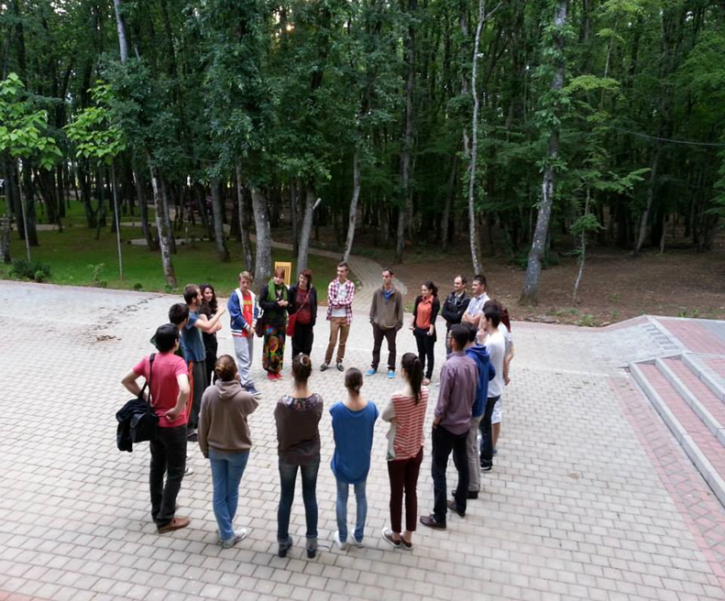
In this context, the teacher is responsible for:
• explaining clearly to the individual and the group, the project and the working procedure;
• providing support for the individual work and the balance of the group.
Notes:
In this context, the teacher is responsible for:
• explaining clearly to the individual and the group, the project and the working procedure;
• providing support for the individual work and the balance of the group.

Slide 23

Alternanza scuola-lavoro (Work-linked training experience) (1)
The experience was positive but there were also critical aspects on which we are working.
Among them:
Need to acquire a collegial teaching methodology
Appropriate requirements for external parties
Measures in the area of safety, hygiene and health surveillance
Collaboration in educational planning between school and company
Notes:
Alternanza scuola-lavoro (Work-linked training experience) (1)
The experience was positive but there were also critical aspects on which we are working.
Among them:
Need to acquire a collegial teaching methodology
Appropriate requirements for external parties
Measures in the area of safety, hygiene and health surveillance
Collaboration in educational planning between school and company

Slide 24
Alternanza scuola-lavoro (Work-linked training experience) (2)
Commitment and involvement of teachers
Forms
"Measurement" and "evaluation" of the experience for the purposes of State examinations
ASL Organisation for students with disabilities
Necessity:
To characterize ASL specificity compared to traditional internships
To structure better the educational contribution of the company
(Even with testing, different form of evaluation)
Notes:
Alternanza scuola-lavoro (Work-linked training experience) (2)
Commitment and involvement of teachers
Forms
"Measurement" and "evaluation" of the experience for the purposes of State examinations
ASL Organisation for students with disabilities
Necessity:
To characterize ASL specificity compared to traditional internships
To structure better the educational contribution of the company
(Even with testing, different form of evaluation)

Slide 25

A new learning grounded in:
collaboration
personalization
active students' engagement
All educational strategies are evolving in order to facilitate the students’ work by suitable instruments to engage them in their own learning.
Notes:
A new learning grounded in:
collaboration
personalization
active students' engagement
All educational strategies are evolving in order to facilitate the students’ work by suitable instruments to engage them in their own learning.

