Slide 1
Growing Mindsets: Growing a Community
Affecting the mindsets of staff, pupils, parents and carers
Notes:
Growing Mindsets: Growing a Community
Affecting the mindsets of staff, pupils, parents and carers

Slide 2
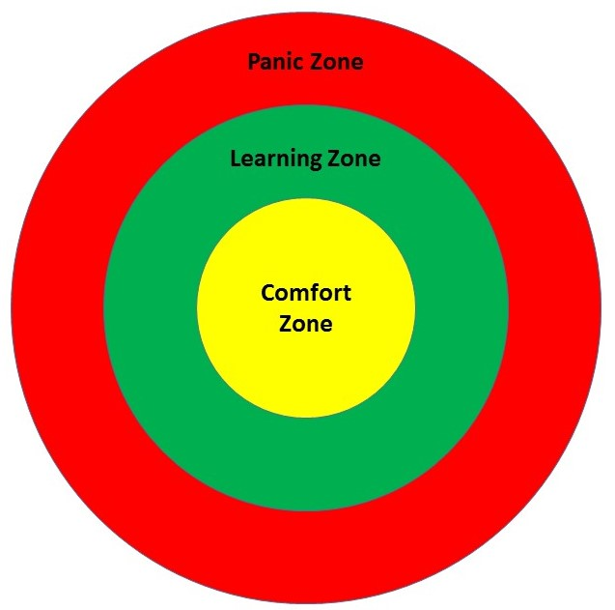
Growing Mindsets
Notes:
Growing Mindsets
An inner circle represents the Comfort Zone, with a circle surrounding it representing the Learning Zone and an outer circle representing the Panic Zone.

Slide 3
Growing Mindsets: Resources
Table Tennis Tables – Reducing barriers
We had a performance average of 53.1 compared to 47.7 which is well over 5 marks per pupil. This would take us ‘top of the charts’ on previous years comparative data.
8 A’s to 14 A’s – 38% achieved a band.
Notes:
Growing Mindsets: Resources
Table Tennis Tables – Reducing barriers
We had a performance average of 53.1 compared to 47.7 which is well over 5 marks per pupil. This would take us ‘top of the charts’ on previous years comparative data.
8 A’s to 14 A’s – 38% achieved a band.

Slide 4
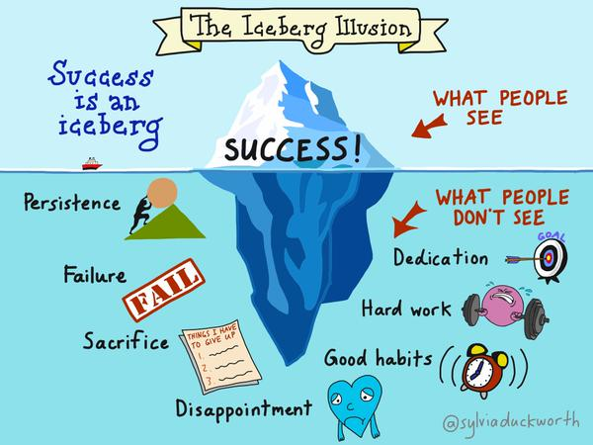
Growing Mindsets: Ownership of learning
Notes:
Growing Mindsets: Ownership of learning
Success is an iceberg. An image of an iceberg floating in the sea. The smaller section of the iceberg shows above the water and represents success and what people see. Below the water is a larger part of the iceberg, representing what people don't see: persistence, failure, sacrifice, disappointment, dedication, hard work and good habits.

Slide 5
Growing Mindsets: Staff Training
Meeting Learners’ Needs Group
Removing Barriers – ESOL
Building Capacity
NQT Ongoing Training
LAC Mentors
Notes:
Growing Mindsets: Staff Training
Meeting Learners’ Needs Group
Removing Barriers – ESOL
Building Capacity
NQT Ongoing Training
LAC Mentors

Slide 6
Growing Mindsets: Affecting staff mindsets (1)
Watch the video about adopting a growth mindset
Notes:
Growing Mindsets: Affecting staff mindsets (1)
Watch the video about adopting a growth mindset
https://www.youtube.com/watch?v=Z1HQadaWYSw

Slide 7
Growing Mindsets: Empowerment through coaching
Coaching Mentoring
“The coach is not a problem solver, a teacher, an adviser, an instructor or even an expert: he or she is a sounding board, facilitator… who raises awareness and responsibility”
(Whitmore, 2015)
Notes:
Growing Mindsets: Empowerment through coaching
Coaching Mentoring
“The coach is not a problem solver, a teacher, an adviser, an instructor or even an expert: he or she is a sounding board, facilitator… who raises awareness and responsibility”
(Whitmore, 2015)

Slide 8
Growing Mindsets: Growing the culture of the school
Resilient, ambitious, reflective learners
Positive contributions from stakeholders
Teachers are learners
Cross faculty collaboration and professional inquiry
The values and vision of the school is shared by our community
Notes:
Growing Mindsets: Growing the culture of the school
Resilient, ambitious, reflective learners
Positive contributions from stakeholders
Teachers are learners
Cross faculty collaboration and professional inquiry
The values and vision of the school is shared by our community

Slide 9
Growing Mindsets: Affecting staff mindsets (2)
Watch the video about teacher training
Notes:
Growing Mindsets: Affecting staff mindsets (2)
Watch the video about teacher training
http://www.european-agency.org/sites/default/files/16.%20Teacher%20training%20%28Scottish%20LC%29.mp4

