Slide 1

Education For All
MINISTRY FOR EDUCATION AND EMPLOYMENT
Our Values
Our Organisation
Our Initiatives
Notes:
Education For All
MINISTRY FOR EDUCATION AND EMPLOYMENT
Our Values
Our Organisation
Our Initiatives

Slide 2
Education for All (1)
Audit 2015
Results
Audit 2015
Recommendations
Development Model
Education for All
Notes:
Education for All (1)
Audit 2015
Results
Audit 2015
Recommendations
Development Model
Education for All

Slide 3
Results
Results
Inclusive education is seen as fragmented and not sufficiently coherent;
Inclusion is viewed as ‘just another initiative’ or a ‘charitable’ initiative, instead of as a learner’s right;
Stakeholders do not feel sufficiently enabled and empowered.
Creating clarity around the concept of inclusion leading to a review of legislation and policy
Re-focusing support to increase the capacity of colleges and schools to meet all learners’ needs
Establishing a national training body to provide continuous professional development (skills, knowledge and understanding) for all education leaders, educators and support personnel
Notes:
Results
Inclusive education is seen as fragmented and not sufficiently coherent;
Inclusion is viewed as ‘just another initiative’ or a ‘charitable’ initiative, instead of as a learner’s right;
Stakeholders do not feel sufficiently enabled and empowered.
Creating clarity around the concept of inclusion leading to a review of legislation and policy
Re-focusing support to increase the capacity of colleges and schools to meet all learners’ needs
Establishing a national training body to provide continuous professional development (skills, knowledge and understanding) for all education leaders, educators and support personnel

Slide 4
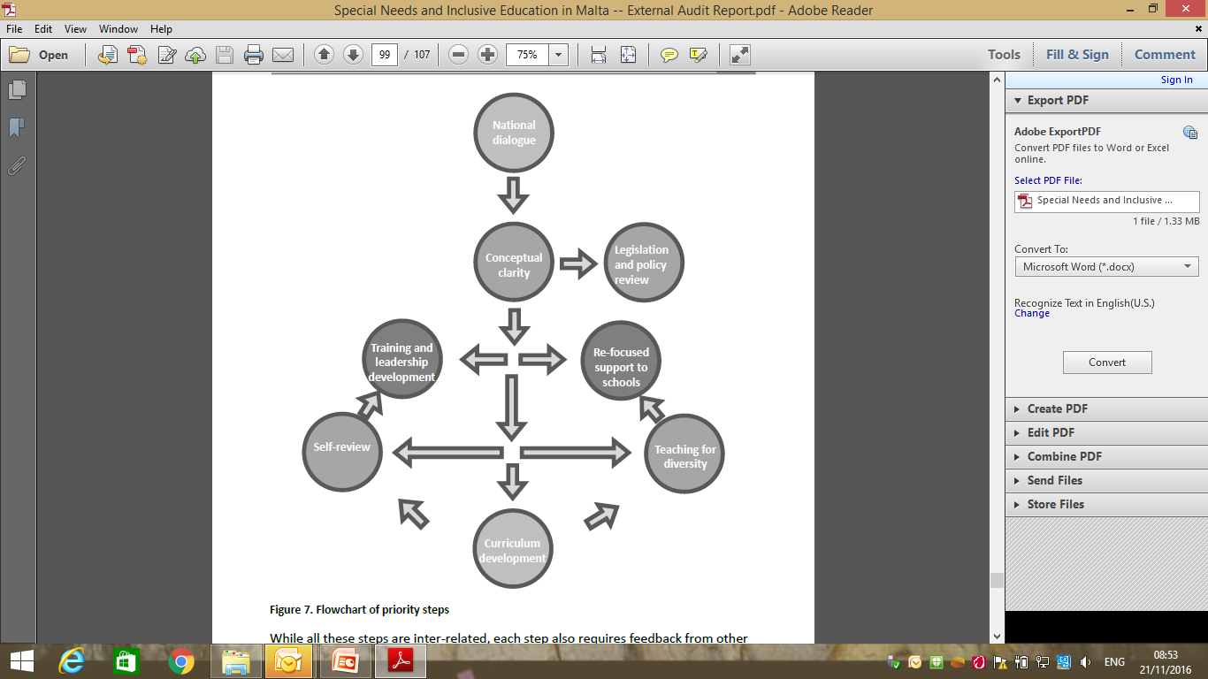
Recommendations
Audit
Recommendations Audit 2015
Notes:
Recommendations
Audit 2015
The diagram shows the inter-connected recommendations from the Agency audit in Malta in 2015: national dialogue, conceptual clarity, legislation and policy review, training and leadership development, self-review, curriculum development, teaching for diversity, re-focused support to schools

Slide 5
Implementation of Recommendations
Recommendation: National Dialogue
Setting up of “Education for All” structures and developmental process:
Steering Committee, Core Group, Stakeholder Dialogue, Development Team
Notes:
Implementation of Recommendations
Recommendation: National Dialogue
Setting up of “Education for All” structures and developmental process:
Steering Committee, Core Group, Stakeholder Dialogue, Development Team
Austrian Delegation 24/10/16

Slide 6
Education for All guiding principle
High Quality Education for All, through dialogue, resolves to work and support all stakeholders in order to ensure that each and every learner will learn to know, to do, to be and to live together
Notes:
Whole school philosophy
Education for All guiding principle
High Quality Education for All, through dialogue, resolves to work and support all stakeholders in order to ensure that each and every learner will learn to know, to do, to be and to live together

Slide 7

Education for All adopts a whole school approach philosophy
Working collectively and collaboratively to improve student learning, behaviour, well being and the conditions that support these practices
Senior Management Team
Teachers: Early years, Primary, Middle and Senior
Students
Parents and families
Learning Support Assistants
Local Organisations
Ancillary staff members
Residents
Notes:
Education for All adopts a whole school approach philosophy
Working collectively and collaboratively to improve student learning, behaviour, well being and the conditions that support these practices
Senior Management Team
Students
Parents and families
Local Organisations
Residents
Ancillary staff members
Learning Support Assistants
Teachers: Early years, Primary, Middle and Senior

Slide 8
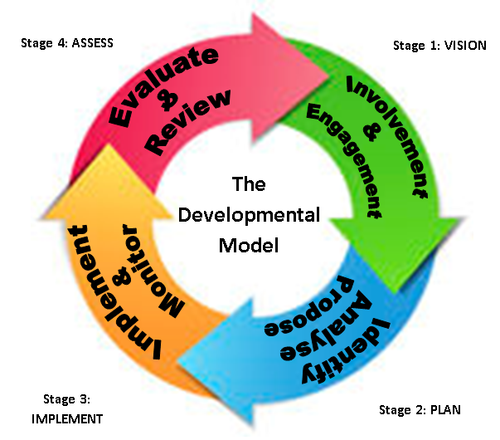
The Developmental Model
Evaluation and reviewing of project
Development of concepts of priority areas in consultation with different stakeholders.
Education for All project in 2 primary schools from 2 Colleges in Malta and 1 in Gozo
Working Groups developing action plans
Notes:
The Developmental Model
The diagram shows the developmental model adopted in Malta which consists of:
Stage 1 Vision (involvement and engagement of stakeholders; Development of concepts of priority areas in consultation with different stakeholders), Stage 2 plan (identify, analyse and propose actions; Working Groups developing action plans), Stage 3 implement (implement and monitor; Education for All project in 2 primary schools from 2 Colleges in Malta and 1 in Gozo), then Stage 4 assess (evaluate and review; Evaluation and reviewing of project).

Slide 9
Recommendation: creating conceptual clarity around the concept of inclusion
From
Special Needs
Education for All
Learners with Special Needs
All Learners
Knowing & addressing the needs of all learners
Notes:
Recommendation: creating conceptual clarity around the concept of inclusion
From
Special Needs to Education for All
Learners with Special Needs to All Learners
Knowing & addressing the needs of all learners

Slide 10

Development of Other Recommendations
Stakeholders
College Principals and Heads of Schools (roll out)
Steering Committee
Core Group
Development Team
Respective working groups including:
College Principals
SMT (Church, State, Independent)
Educators
Parents
Notes:
Development of Other Recommendations
Stakeholders
College Principals and Heads of Schools (roll out)
Steering Committee
Core Group
Development Team
Respective working groups including:
College Principals
SMT (Church, State, Independent)
Educators
Parents
The diagram shows further recommendations from the Agency audit in Malta regarding training and leadership, teaching for diversity, curriculum development and self-review

Slide 11
Priority Areas emerging from recommendations and Stakeholders
Leadership and Good Governance
Organisation of Support, Resource and Strategies in Colleges and Schools
Initial Training and CPD
Curriculum Development
Positive Learning Communities
Evaluation and Internal review
Research
Notes:
Priority Areas emerging from recommendations and Stakeholders
Leadership and Good Governance
Organisation of Support, Resource and Strategies in Colleges and Schools
Initial Training and CPD
Curriculum Development
Positive Learning Communities
Evaluation and Internal review
Research

Slide 12
Priority Area: Leadership and Good Governance
Leaders at all levels that:
Have vision, mission and values
Create teams, empower people, and develop stakeholders’ potential
Facilitate constructive dialogue with all stakeholders leading to a clear plan of action while catering for the needs of all learners
Think creatively and use innovative and pro-active strategies in order to challenge the status quo and bring about change in practices, policies and structures
Notes:
Priority Area: Leadership and Good Governance
Leaders at all levels that:
Have vision, mission and values
Create teams, empower people, and develop stakeholders’ potential
Facilitate constructive dialogue with all stakeholders leading to a clear plan of action while catering for the needs of all learners
Think creatively and use innovative and pro-active strategies in order to challenge the status quo and bring about change in practices, policies and structures

Slide 13
Priority Area: Positive Learning Communities
Parental Engagement
Learner Engagement
Community Engagement
Notes:
Priority Area: Positive Learning Communities
Parental Engagement
Learner Engagement
Community Engagement

Slide 14
Priority Area: Enhancing a culture of internal review and research
Evaluation and review of current processes and procedures within the educational systems
Identification of the current strengths, weaknesses and needs at national, college and school level
Strengthening of decision making processes
Development of informed national, college and school policies based on the strengths
Notes:
Priority Area: Enhancing a culture of internal review and research
Evaluation and review of current processes and procedures within the educational systems
Identification of the current strengths, weaknesses and needs at national, college and school level
Strengthening of decision making processes
Development of informed national, college and school policies based on the strengths

Slide 15
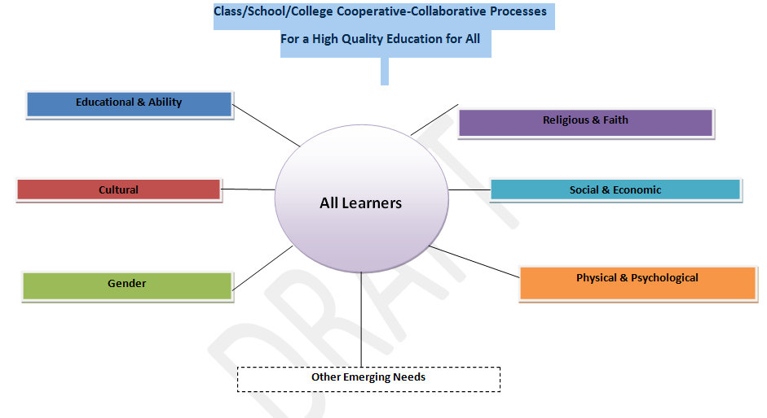
Cooperative and Collaborative Learning
E.g. Communication hubs
E.g. BM 88
E.g. Trans, Gender Variant and Intersex Students in school policy
E.g. Dyslexia-friendly, autism-friendly, accessibility
Notes:
Cooperative and Collaborative Learning
The diagram, entitled ‘Class/School/College Cooperative-Collaborative Processes for a High Quality Education for All’, shows the focus on all learners, including those from ‘at risk’ groups in a cooperative and collaborative learning process. ‘All learners’ appears in the circle at the centre of the diagram. The following terms appear around the circle: Religious and Faith; Social and Economic, e.g. BM 88; Physical and Psychological, e.g. Dyslexia-friendly, autism-friendly, accessibility; gender, e.g. Trans, Gender Variant and Intersex Students in school policy; Cultural, e.g. Communication hubs; Educational and Ability

Slide 16
Class/School/College Support
Teacher together with Class Assistant plan strategies, support and assessment in relation to curriculum for all learners in the class
Monitoring of all learners’ progress
Adjustment of strategy and support
Monitoring and evaluation
When a learner, after the necessary adjustments is still not reaching his set outcomes the class team in consultation with the HoS will call on the support of specialised support staff within the school and College and/or other Agencies and Units according to the needs of the learner to form a professional learning team (PLT).
The PLT will plan more personalised strategies, support and assessment using quality resources.
Learner’s progress continues to be monitored and strategies and support continue to be adjusted accordingly.
Notes:
Class/School/College Support
Teacher together with Class Assistant plan strategies, support and assessment in relation to curriculum for all learners in the class
Monitoring of all learners’ progress
Adjustment of strategy and support
Monitoring and evaluation
When a learner, after the necessary adjustments is still not reaching his set outcomes the class team in consultation with the HoS will call on the support of specialised support staff within the school and College and/or other Agencies and Units according to the needs of the learner to form a professional learning team (PLT).
The PLT will plan more personalised strategies, support and assessment using quality resources.
Learner’s progress continues to be monitored and strategies and support continue to be adjusted accordingly.

Slide 17
Educators
Evaluation and Development
Educators’ Strengths and Areas of Development
Educator – Educator relationship
Educator – Learner relationship
Educator – Community relationship
Up-skilling
Learning and Social Environment
Notes:
Educators
Evaluation and Development
Educators’ Strengths and Areas of Development
Educator – Educator relationship
Educator – Learner relationship
Educator – Community relationship
Up-skilling
Learning and Social Environment

Slide 18
Action Research
In order to continually improve on the quality and processes a review mechanism will be set up as an integral development process to the implementation
Notes:
Action Research
In order to continually improve on the quality and processes a review mechanism will be set up as an integral development process to the implementation

Slide 19
In conclusion
The Education for All
is a process of development within schools
that aims to provide high quality educational experiences resulting from
meeting the diverse needs of each learner
in order to ensure that each learner achieves through learning to know, to do, to be and to live together.
This can only be achieved by moving away from a one size fits all system of education.
Notes:
In conclusion
The Education for All
is a process of development within schools
that aims to provide high quality educational experiences resulting from
meeting the diverse needs of each learner
in order to ensure that each learner achieves through learning to know, to do, to be and to live together.
This can only be achieved by moving away from a one size fits all system of education.
Austrian Delegation 24/10/16

Slide 20

Thank you
Notes:
Thank you

