Slide 1


Managing educational change – building learning communities
Notes:
Managing educational change – building learning communities

Slide 2
Two inter-connected themes…
Challenges in and reflections on the RA project:
  The role of learning communities (LCs) in educational improvement
  How to develop LCs
The development of the Nordic network as an example of a learning community
Notes:
Two inter-connected themes…
Challenges in and reflections on the RA project:
The role of learning communities (LCs) in educational improvement
How to develop LCs
The development of the Nordic network as an example of a learning community

Slide 3
Fundamental challenges in many European systems – indicated by the RA project and in the ‘north’
A loss or lack of confidence and collective efficacy at several levels – leaders, teachers and pupils
The term ‘inclusion’ is not often used at the policy level; a positive-negative debate from a ‘placement view’
Schools as rather hectic, stressed and day-by-day driven activities and cultures, with a lack of a systemic view on the ‘actions’
Research is mostly one-level studies – need for multi-level studies
Notes:
Fundamental challenges in many European systems – indicated by the RA project and in the ‘north’
A loss or lack of confidence and collective efficacy at several levels – leaders, teachers and pupils
The term ‘inclusion’ is not often used at the policy level; a positive-negative debate from a ‘placement view’
Schools as rather hectic, stressed and day-by-day driven activities and cultures, with a lack of a systemic view on the ‘actions’
Research is mostly one-level studies – need for multi-level studies

Slide 4
Fundamental challenges… (continued)
Quick fixes isolated within the schools instead of more development-oriented models
Pupils who in general do not make enough progress, since the system has not yet developed the capability to ‘catch’ progression
A risk of too many reforms at the same time can reduce the confidence of foremost the teachers, but also principals
A need for a fundamentally new thinking concerning how to learn to be a functioning teacher, principal and head of education
Notes:
Fundamental challenges… (continued)
Quick fixes isolated within the schools instead of more development-oriented models
Pupils who in general do not make enough progress, since the system has not yet developed the capability to ‘catch’ progression
A risk of too many reforms at the same time can reduce the confidence of foremost the teachers, but also principals
A need for a fundamentally new thinking concerning how to learn to be a functioning teacher, principal and head of education

Slide 5
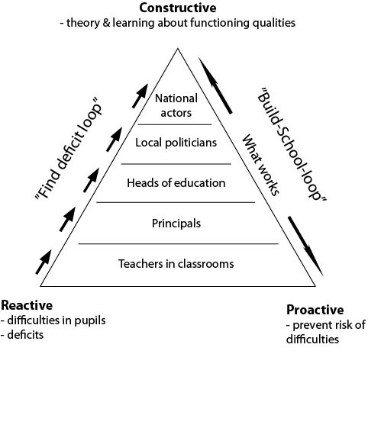
Underneath is a fundamental challenge of inclusion
Skoglund & Stäcker, 2016
Notes:
Underneath is a fundamental challenge of inclusion
Skoglund & Stäcker, 2016
Triangle illustrating the move away from a deficit view and reactive patterns
Bottom left corner: Reactive (difficulties in pupils and deficits).
Bottom right corner: Proactive (prevent risk of difficulties).
Top corner: Constructive (theory and learning about functioning qualities).
Actors (from bottom upwards): Teachers in classrooms, Principals, Heads of education, Local politicians, and National actors.
Left side going upwards: 'Find-deficit loop'.
Right side going both ways: 'Build-school loop'. What works.

Slide 6
This finding means….
You cannot, or at least it is hard to:
instrumentally ‘copy cat’ what others have done
run away from yourself, the context and situation where you are ‘placed’.
Therefore,
You have to start with yourself and build your learning community!
Notes:
This finding means….
You cannot, or at least it is hard to:
instrumentally ‘copy cat’ what others have done
run away from yourself, the context and situation where you are ‘placed’.
Therefore,
You have to start with yourself and build your learning community!

Slide 7
Development of learning communities as means for authentic school development
Notes:
Development of learning communities as means for authentic school development

Slide 8
What we learned about LCs from earlier projects
Flensburg & Essunga change processes: (European Agency, 2014; Skoglund, 2014a)
4. The need for an explicit idea of school and pupils built on research
1. Reality
5. The need for change in thinking and acting – visibility, support, variation
2. Oneself as causal factor
Learn and change by accepting
6. The need to build a stronger community of practice – support each other
3. To move from resource allocation to resource use
7. The professional ability to learn as fundamental to pupil learning and school innovation
Notes:
What we learned about LCs from earlier projects
Flensburg & Essunga change processes: (European Agency, 2014; Skoglund, 2014a)
Learn and change by accepting...1. Reality, 2. Oneself as causal factor, 3. To move from resource allocation to resource use, 4. The need for an explicit idea of school and pupils built on research, 5. The need for change in thinking and acting – visibility, support, variation, 6. The need to build a stronger community of practice – support each other, 7. The professional ability to learn as fundamental to pupil learning and school innovation

Slide 9
The essence of creating learning communities is ‘to ground it’!
‘Is and Why come before Ought’
‘Plementation comes before Implementation’
Notes:
The essence of creating learning communities is ‘to ground it’!
‘Is and Why come before Ought’
‘Plementation comes before Implementation’

Slide 10
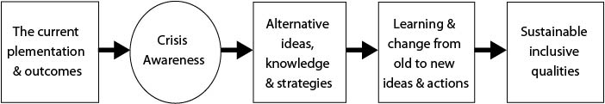
A move from technical implementation to true cultural transformation and institutionalisation – a matter of local analysis
(Skoglund & Stäcker, 2016)
Knowledge in practice ➔ ➔ ➔
Knowledge of practice ➔ ➔
Knowledge for practice ➔ ➔
New knowledge in practice
Analysis 1:
How it is in local context?
Analysis 2:
Why it is in local context?
Analysis 3:
Why it is in general?
Analysis/ Synthesis 4:
‘Theory of change’
Proven practice
Notes:
A move from technical implementation to true cultural transformation and institutionalisation – a matter of local analysis
(Skoglund & Stäcker, 2016)
The current 'plementation' and outcomes lead to crisis awareness, which triggers alternative ideas, knowledge and strategies, leading to learning and change from old to new ideas and actions, and to sustainable inclusive qualities.
The diagram shows steps in moving from technical implementation to cultural transformation through an analysis of the local situation. The steps include taking on alternative ideas, knowledge and strategies and developing a ‘theory of change’ to put new ideas into practice to develop sustainable inclusive qualities. Knowledge in practice (Analysis 1: How it is in local context?; Analysis 2: Why it is in local context?); Knowledge of practice (Analysis 3: Why it is in general?); Knowledge for practice (Analysis/ Synthesis 4: ‘Theory of change’); New knowledge in practice (Proven practice).

Slide 11
Barriers to and enablers of development
Barriers
Conflicting accountability
Individualistic leadership
Fragmented strategy
Solitary institutions – in competition
Enablers
Constructive, inclusive accountability
Collaborative, distributed leadership
Coherent, systemic strategy
Networked institutions – critical friends
Fullan, 2010; compare Ainscow, 2008 and Carringston & Robinson, 2006
Notes:
Barriers to and enablers of development
Barriers
Conflicting accountability
Individualistic leadership
Fragmented strategy
Solitary institutions – in competition
Enablers
Constructive, inclusive accountability
Collaborative, distributed leadership
Coherent, systemic strategy
Networked institutions – critical friends
Fullan, 2010; compare Ainscow, 2008 and Carringston & Robinson, 2006
Developed from RA project lit. review – barriers and enablers of LC development (adapted from Fullan et al. ‘wrong drivers’ 2011 – and others)
- overlap with factors enabling inclusion

Slide 12
Barrier and enablers (continued)
Barriers
Uncertainty, fear of change, risk avoidance
Extrinsic motivation – short-term view
Narrow (academic, economic) focus on ‘measurable’ outcomes
Enablers
Consensus, mutual support – building capacity for innovation
Intrinsic motivation – shared commitment to long-term vision
Focus on participation, broader achievement linked to values
Notes:
Barrier and enablers (continued)
Barriers
Uncertainty, fear of change, risk avoidance
Extrinsic motivation – short-term view
Narrow (academic, economic) focus on ‘measurable’ outcomes
Enablers
Consensus, mutual support – building capacity for innovation
Intrinsic motivation – shared commitment to long-term vision
Focus on participation, broader achievement linked to values

Slide 13
An underlying transformation
From ‘Special capacity’ to ‘Inclusive capability’
Notes:
An underlying transformation
From ‘Special capacity’ to ‘Inclusive capability’

Slide 14
Special Capacity and Inclusive Capability
The Anticipation-Expert Model (Special Capacity)
Resources/Funding: Specified by the individual
Needs classification: Diagnosis of child
Curriculum: Highly specified for special need groups
Organisation & Management:
Special schools/classes for specified needs
Pedagogy: Specific group designed
Assessment: High expectations on ‘special expertise’, rather than on teachers and pupils
The Resilience-Collaborative Model (Inclusive Capability)
Resources/Funding: General and plus (by need)
Needs classification: Diagnosis of professional system – child-relation
Curriculum: General agility (for all/each)
Organisation & Management:
Schools for all with continuum of ‘plus support’
Pedagogy: Generally designed, but focus on individual support needs
Assessment: High expectations on capability of school collaboration & pupils’ capability
Notes:
Special Capacity and Inclusive Capability
The Anticipation-Expert Model (Special Capacity)
Resources/Funding: Specified by the individual
Needs classification: Diagnosis of child
Curriculum: Highly specified for special need groups
Organisation & Management:
Special schools/classes for specified needs
Pedagogy: Specific group designed
Assessment: High expectations on ‘special expertise’, rather than on teachers and pupils
The Resilience-Collaborative Model (Inclusive Capability)
Resources/Funding: General and plus (by need)
Needs classification: Diagnosis of professional system – child-relation
Curriculum: General agility (for all/each)
Organisation & Management:
Schools for all with continuum of ‘plus support’
Pedagogy: Generally designed, but focus on individual support needs
Assessment: High expectations on capability of school collaboration & pupils’ capability

Slide 15
The role of learning communities in improving education systems
The traditional individualistic conception of learning has been challenged by more community-centred approaches to learning.
(Haakarainen, 2010; Nilholm & Göransson, 2013)
Haakarainen (2010) states that there has been a major theoretical-methodological shift:
From teacher-centred toward learner-centred approaches
From individually-oriented toward social-oriented processes
From laboratory studies towards studies in real life
Notes:
The role of learning communities in improving education systems
The traditional individualistic conception of learning has been challenged by more community-centred approaches to learning.
(Haakarainen, 2010; Nilholm & Göransson, 2013)
Haakarainen (2010) states that there has been a major theoretical-methodological shift:
From teacher-centred toward learner-centred approaches
From individually-oriented toward social-oriented processes
From laboratory studies towards studies in real life

Slide 16
The value and the conception of the LC
‘Organisations are more likely to be effective learners where they form communities of practice in networks or other collaborative arrangements’
(Muijs et al., 2010, p. 9).
Professional learning communities ‘involve developing communities of learners in which teachers and school leaders work together to improve the learning conditions and results for students in given schools’
(Fullan, 2007, p. 30).
The Raising Achievement project:
‘collaboration of education stakeholders around clusters of schools involving school and community personnel, together with researchers, local area leaders and policy-makers’ (EA, 2016)
– and in collaboration with ‘critical friends’ from 29 countries.
Notes:
The value and the conception of the LC
‘Organisations are more likely to be effective learners where they form communities of practice in networks or other collaborative arrangements’
(Muijs et al., 2010, p. 9).
Professional learning communities ‘involve developing communities of learners in which teachers and school leaders work together to improve the learning conditions and results for students in given schools’
(Fullan, 2007, p. 30).
The Raising Achievement project:
‘collaboration of education stakeholders around clusters of schools involving school and community personnel, together with researchers, local area leaders and policy-makers’ (EA, 2016)
– and in collaboration with ‘critical friends’ from 29 countries.

Slide 17
The current evidence…
‘Where improvements in pupil performance have been seen, this is often where more effective schools have paired with less effective schools to help them to improve, where leadership has been strong and supportive of networking and where the number of schools involved has been limited’
(Muijs et al., 2010, p. 24).
Notes:
The current evidence…
‘Where improvements in pupil performance have been seen, this is often where more effective schools have paired with less effective schools to help them to improve, where leadership has been strong and supportive of networking and where the number of schools involved has been limited’
(Muijs et al., 2010, p. 24).

Slide 18
Reflections on LC development
Reflection on the meaning of inclusion (beyond placement) – importance of shared understanding (how can such an understanding be developed?)
Recognition of how inclusive practice contributes to all learners’ achievement (learning from peers, focus on cognitive as well as social learning for learners with more complex disabilities)
Notes:
Reflections on LC development
Reflection on the meaning of inclusion (beyond placement) – importance of shared understanding (how can such an understanding be developed?)
Recognition of how inclusive practice contributes to all learners’ achievement (learning from peers, focus on cognitive as well as social learning for learners with more complex disabilities)
Meaning of inclusion – OoP – conceptual clarity, contextual analysis,
Teachers finding different ways for learners to respond

Slide 19
Reflections on LC development (continued)
Building learning communities and partnerships for new knowledge and support – making the real ideal…
Relationships – democracy as a value AND a method
Difference, uncertainty, things that ‘disturb’ usual practice as sources of creativity
Notes:
Reflections on LC development (continued)
Building learning communities and partnerships for new knowledge and support – making the real ideal…
Relationships – democracy as a value AND a method
Difference, uncertainty, things that ‘disturb’ usual practice as sources of creativity
Teaching approaches, Leadership, collaboration

Slide 20
Phases of development of learning communities
Identification of barriers ? National/local/school system?
Recognition – local/national
Sharing with others – transfer of ideas requires analysis/support – cross-pollination – not cloning (Hargreaves and Shirley 2009)
Realistic pace of change – how is it/why is it/how could it be…
Notes:
Phases of development of learning communities
Identification of barriers ? National/local/school system?
Recognition – local/national
Sharing with others – transfer of ideas requires analysis/support – cross-pollination – not cloning (Hargreaves and Shirley 2009)
Realistic pace of change – how is it/why is it/how could it be…

Slide 21
Transformation direction in the project
‘Find-Deficit Loop’
Reactive leadership
Reactive (by side) support
Negative (deficit)
Distrusting
Teacher fear
Pupil passivism
Summative recognition
Curriculum rigidity
Standardised pedagogy and support
Formal achievement
‘Build-School Loop’
Constructive leadership
Proactive (in side) system support
Positive (talent) attitude
Trusting collaboration and learning
Teacher confidence
Pupil participation
Formative recognition
Curriculum adaptation
Adaptive pedagogy and support
Real-life competencies
Notes:
Transformation direction in the project
‘Find-Deficit Loop’
Reactive leadership
Reactive (by side) support
Negative (deficit)
Distrusting
Teacher fear
Pupil passivism
Summative recognition
Curriculum rigidity
Standardised pedagogy and support
Formal achievement
‘Build-School Loop’
Constructive leadership
Proactive (in side) system support
Positive (talent) attitude
Trusting collaboration and learning
Teacher confidence
Pupil participation
Formative recognition
Curriculum adaptation
Adaptive pedagogy and support
Real-life competencies

Slide 22
A summative model from the project
School-Based Activities
Parents as resource
Local actors as resource: firms, clubs
University as resource
Inter-national critical friends
‘Constructive leadership’?
‘Positive attitude’?
‘Trustful collaboration’?
‘Teacher confidence’?
‘Pupil participation’?
‘Proactive support’?
‘Formative recognition of pupils’?
PARTNER NETWORKING
‘Curriculum adoption’?
Attainment & Achievement?
pupil confidence?
pupil learning ability?
pupil competencies?
higher studies?
employment?
Adaptive pedagogical strategies and support
Notes:
A summative model from the project
Parents as resource
Local actors as resource: firms, clubs
University as resource
Inter-national critical friends
The model provides an overview of the RA project.
School-based activities develop: Constructive leadership; Positive attitude; Trustful collaboration’; Teacher confidence; Pupil participation; Proactive support.
These support formative recognition of pupils; curriculum adoption; adaptive pedagogical strategies and support, leading to attainment and achievement – including pupil confidence, learning ability, competencies, higher studies and employment. All activities depend on networking with parents, local community, other institutions such as Universities and national/international critical friends.

Slide 23
The Essence
Focus on developing the ‘inclusive capability’ of the educational system as a whole and encourage strong links, collaboration and support between and within all actor levels
Inclusion is about continuous work to increase professionals (teachers, support actors and leaders) capability to see, understand and adapt school and teaching to the needs of all pupils
Autos O cosmos O micros O megas (Elytis, 1979)
Notes:
The Essence
Focus on developing the ‘inclusive capability’ of the educational system as a whole and encourage strong links, collaboration and support between and within all actor levels
Inclusion is about continuous work to increase professionals (teachers, support actors and leaders) capability to see, understand and adapt school and teaching to the needs of all pupils
Autos O cosmos O micros O megas (Elytis, 1979)

Slide 24
Inclusion = those responsible for and in schools striving to increase capability to:
Constructive Leadership
‘Reactive’
special support
‘Proactive special support’
Adaptive teaching
recognition
deep investigation
create action plan
work out action plan
evaluate outcomes
Understand
See/Hear
Meet
Offer
Individual development plan
Pupil Participation
Skoglund, 2014a
Notes:
Inclusion = those responsible for and in schools striving to increase capability to:
The diagram shows the progression taken by schools increasing their capability to include all learners and improve pupil participation. Through constructive leadership, proactive support should meet learners, see/hear and understand them and adapt teaching – also reacting to special requirements.
Skoglund, 2014a

Slide 25
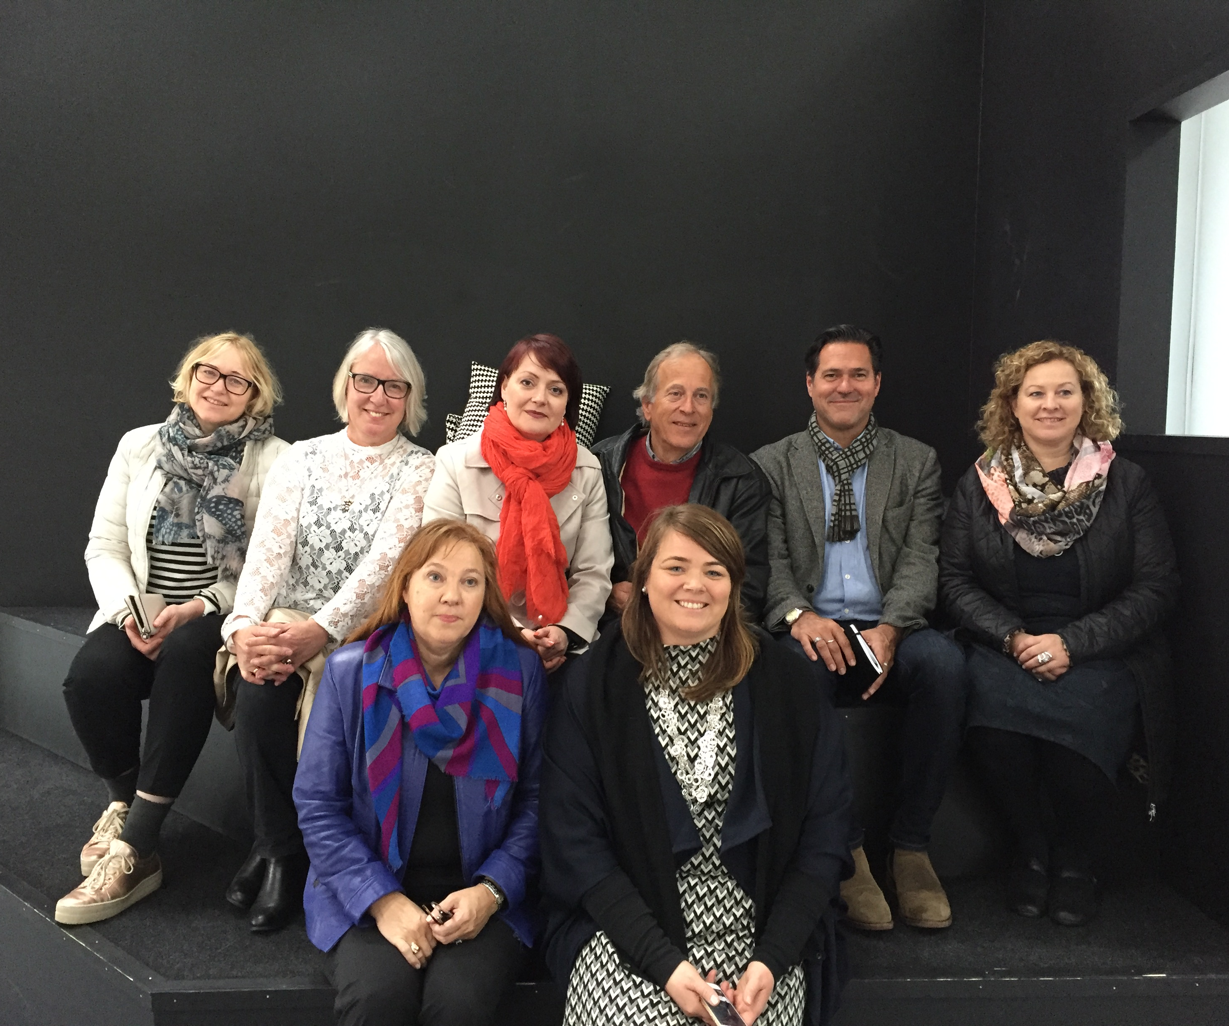
Nordic Network – an example of a growing learning community
In the photo:
Anne Lium Berger (Norway)
Grethe Andersen (Denmark)
Merja Koivisto (Finland)
Svein Erik Nergaard (Norway)
Per Skoglund (Sweden)
Jenný Gunnbjörnsdóttir (Iceland)
Pirjo Koivula (Finland)
Kristín Jóhannesdóttir (Iceland)
Absent:
Mari-Paulina Vainakainen (Finland)
Charlotta Pettersson (Sweden)
Bengt Weidow (Sweden)
Notes:
Nordic Network – an example of a growing learning community
In the photo:
Anne Lium Berger (Norway)
Grethe Andersen (Denmark)
Merja Koivisto (Finland)
Svein Erik Nergaard (Norway)
Per Skoglund (Sweden)
Jenný Gunnbjörnsdóttir (Iceland)
Pirjo Koivula (Finland)
Kristín Jóhannesdóttir (Iceland)
Absent:
Mari-Paulina Vainakainen (Finland)
Charlotta Pettersson (Sweden)
Bengt Weidow (Sweden)

Slide 26
Nordic Network
Internal aims:
To collaborate and learn together among the Nordic countries concerning how to support the school systems to raise inclusive capabilities
To highlight national tendencies and contextual cases showing what is possible in each context, and compare experiences
To construct a platform for collaboration in the Nordic Network in large, aiming for a seminar in 2018 with representatives from ministries/agencies, national co-ordinators and active experts
External aims:
To institutionalise a platform for Nordic co-operation in EA projects (here RAAL), and by that give more co-ordinated support from Nordic participants and thereby help visit sites’ development and help the development in the Nordic context by sharing project results
To use this platform for school developments not associated with the EA
To find financial resources for the Network.
Notes:
Nordic Network
Internal aims:
To collaborate and learn together among the Nordic countries concerning how to support the school systems to raise inclusive capabilities
To highlight national tendencies and contextual cases showing what is possible in each context, and compare experiences
To construct a platform for collaboration in the Nordic Network in large, aiming for a seminar in 2018 with representatives from ministries/agencies, national co-ordinators and active experts
External aims:
To institutionalise a platform for Nordic co-operation in EA projects (here RAAL), and by that give more co-ordinated support from Nordic participants and thereby help visit sites’ development and help the development in the Nordic context by sharing project results
To use this platform for school developments not associated with the EA
To find financial resources for the Network.

Slide 27
How is raised achievement for all possible?
Nordic countries: tendencies, cases and preliminary evidence
Successful school development in focus
Inclusion as a matter of increasing inclusive capability
Fundamental challenges/nation
5–7 illuminating cases
Tentative evidence
Forthcoming report/article:
Nordic Light on Inclusion, 2017
Notes:
How is raised achievement for all possible?
Nordic countries: tendencies, cases and preliminary evidence
Successful school development in focus
Inclusion as a matter of increasing inclusive capability
Fundamental challenges/nation
5–7 illuminating cases
Tentative evidence
Forthcoming report/article: Nordic Light on Inclusion, 2017

Slide 28
The future
Application 2017–2020 at Nordplus Horizontal
Visits, revisits and seminars in each country:
Iceland
Finland
Norway
Denmark
Sweden
Widening of the network
Publications
‘Support’ in future EA projects
Notes:
The future
Application 2017–2020 at Nordplus Horizontal
Visits, revisits and seminars in each country:
Iceland
Finland
Norway
Denmark
Sweden
Widening of the network
Publications
‘Support’ in future EA projects

Slide 29

Contacts
Future co-ordinating part: Iceland
Kristín Jóhannesdóttir
Jenný Gunnbjörnsdóttir
Sweden:
Per Skoglund
Charlotta Pettersson
Norway:
Anne Lium Berger
Svein Erik Nergaard
Denmark:
Grethe Andersen
Finland:
Merja Koivisto
Mari-Paulina Vainakainen
Notes:
Contacts
Future co-ordinating part: Iceland
Kristín Jóhannesdóttir
Jenný Gunnbjörnsdóttir
Sweden:
Per Skoglund
Charlotta Pettersson
Norway:
Anne Lium Berger
Svein Erik Nergaard
Denmark:
Grethe Andersen
Finland:
Merja Koivisto
Mari-Paulina Vainakainen

