Slide 1


VISIONARY LEADERSHIP –
VALUED ROLES FOR EVERYONE
Marek Tarwacki, Headteacher of Schools in Łajski, Poland
Virginia Stafiej, Deputy Headteacher of Schools in Łajski, Poland, and Project Expert
Notes:
VISIONARY LEADERSHIP – VALUED ROLES FOR EVERYONE
Marek Tarwacki, Headteacher of Schools in Łajski, Poland
Virginia Stafiej, Deputy Headteacher of Schools in Łajski, Poland, and Project Expert

Slide 2


Overview of presentation
Visionary school management
Needs analysis of students, teachers, assistants and specialists
Headteacher as the leader
Teamwork
Co-operation with parents
Collaboration with institutes and support from other partners
The school as good practice – EA project
Notes:
Overview of presentation
Visionary school management
Needs analysis of students, teachers, assistants and specialists
Headteacher as the leader
Teamwork
Co-operation with parents
Collaboration with institutes and support from other partners
The school as good practice – EA project

Slide 3

1. Visionary school management
School is the place where:
external and
internal expectations
gather, so there is constant need to focus on challenges and to continue activities which are already completed.
Notes:
1. Visionary school management
School is the place where:
external and
internal expectations
gather, so there is constant need to focus on challenges and to continue activities which are already completed.

Slide 4

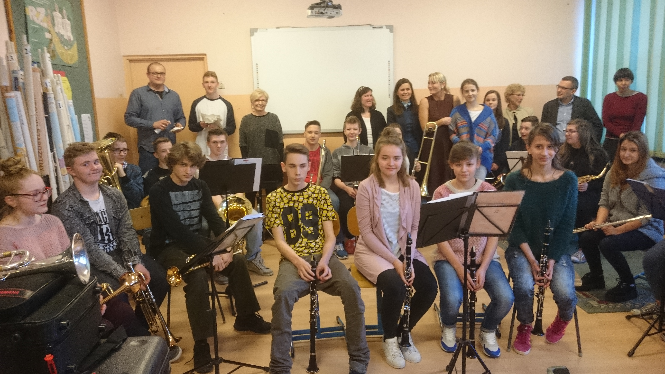
School orchestra photo
Notes:
School orchestra photo

Slide 5
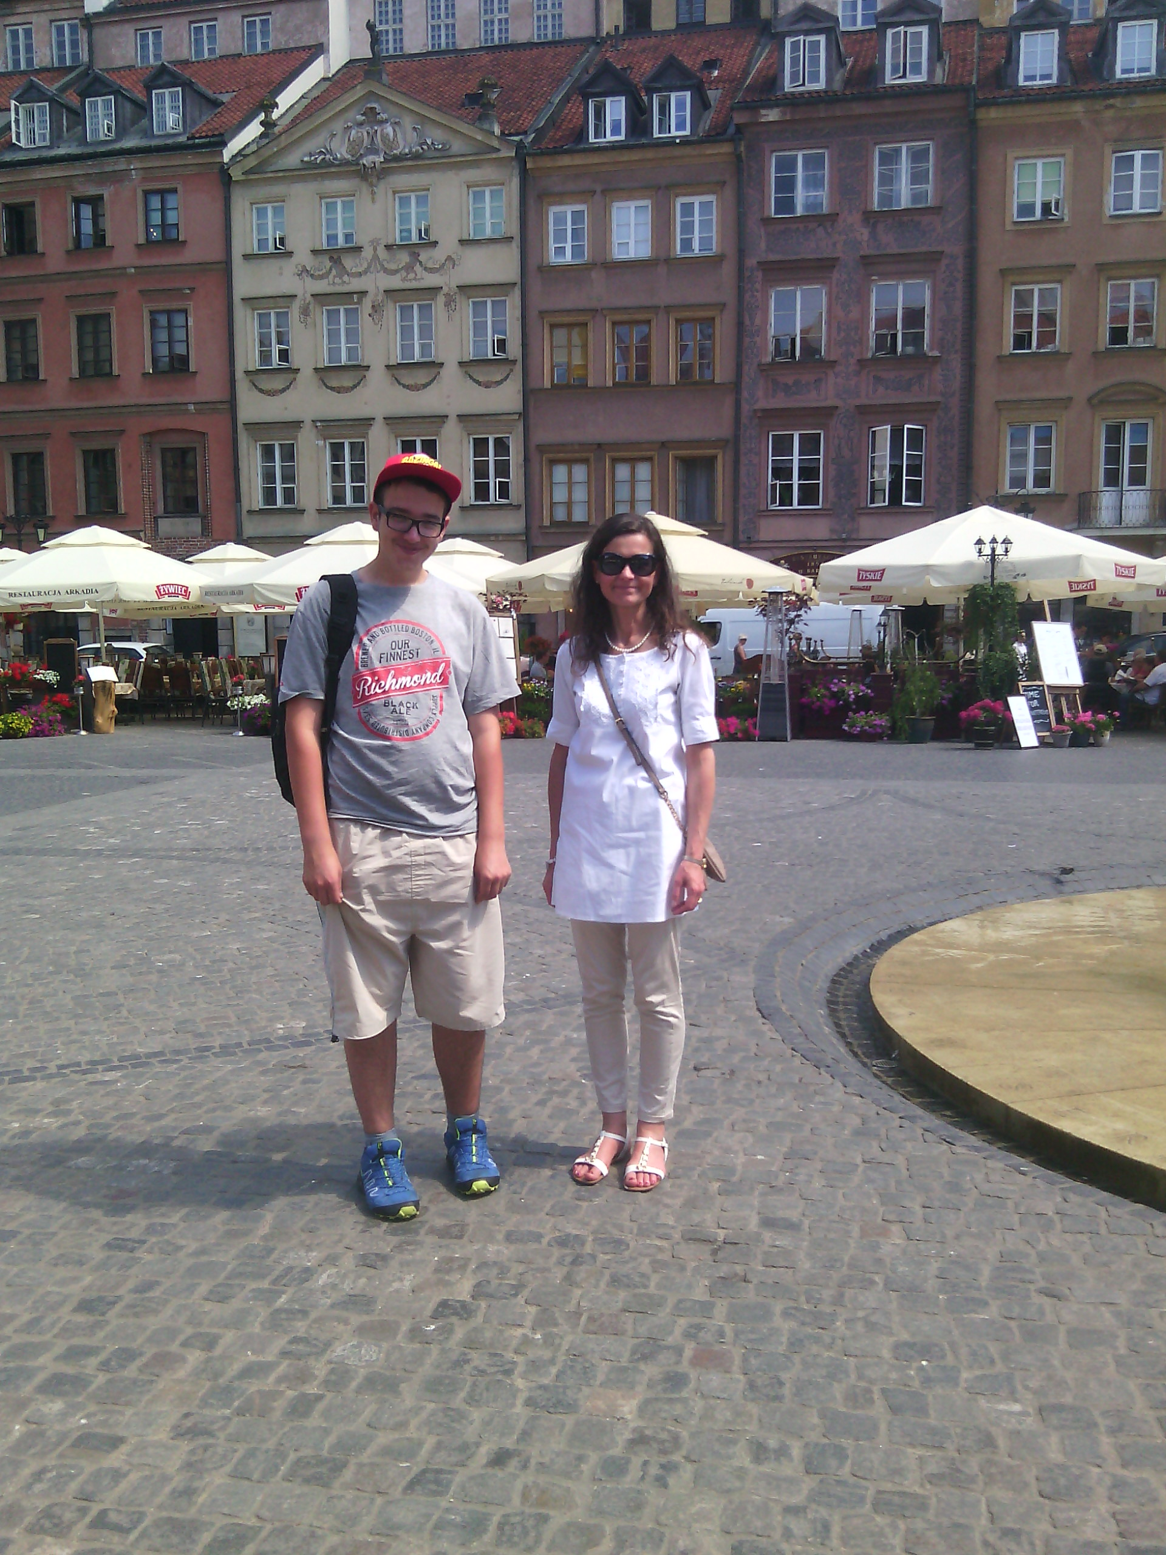
2. Needs analysis (1)
The school headteacher should cover wide aspects of proper leadership:
social environment
technical/place conditions
students’ educational and therapeutical needs
staff’s strengths, motivation and professional development
friendly and kind atmosphere
Notes:
2. Needs analysis (1)
The school headteacher should cover wide aspects of proper leadership:
social environment
technical/place conditions
students’ educational and therapeutical needs
staff’s strengths, motivation and professional development
friendly and kind atmosphere

Slide 6

2. Needs analysis (2)
Students as the inclusive society:
clear rules, clear values and culture of behaviour
individualisation of education – finding abilities, strengths and gifts
learning by teaching others
freedom for self-realisation
help and support among peers
Notes:
2. Needs analysis (2)
Students as the inclusive society:
clear rules, clear values and culture of behaviour
individualisation of education – finding abilities, strengths and gifts
learning by teaching others
freedom for self-realisation
help and support among peers

Slide 7

3. Headteacher as the leader
Headteacher/leader/visionary plans school vision and mission at least 5 years ahead, including:
culture of organisation
ethos promoting education
openness and accountability for co-operation:
learner–teacher/assistant–parents
Notes:
3. Headteacher as the leader
Headteacher/leader/visionary plans school vision and mission at least 5 years ahead, including:
culture of organisation
ethos promoting education
openness and accountability for co-operation:
learner–teacher/assistant–parents

Slide 8
4. Teamwork
Strong feeling of belonging to school learning community
Acceptance of the idea of inclusive education – system of attitudes and values
Lifelong learning – teachers’/assistants’/specialists’ constant development
Teamwork which means ‘everyone can substitute each other’
Every employee is needed and must feel needed
Daily co-operation by sharing knowledge and experience
Notes:
4. Teamwork
Strong feeling of belonging to school learning community
Acceptance of the idea of inclusive education – system of attitudes and values
Lifelong learning – teachers’/assistants’/specialists’ constant development
Teamwork which means ‘everyone can substitute each other’
Every employee is needed and must feel needed
Daily co-operation by sharing knowledge and experience

Slide 9
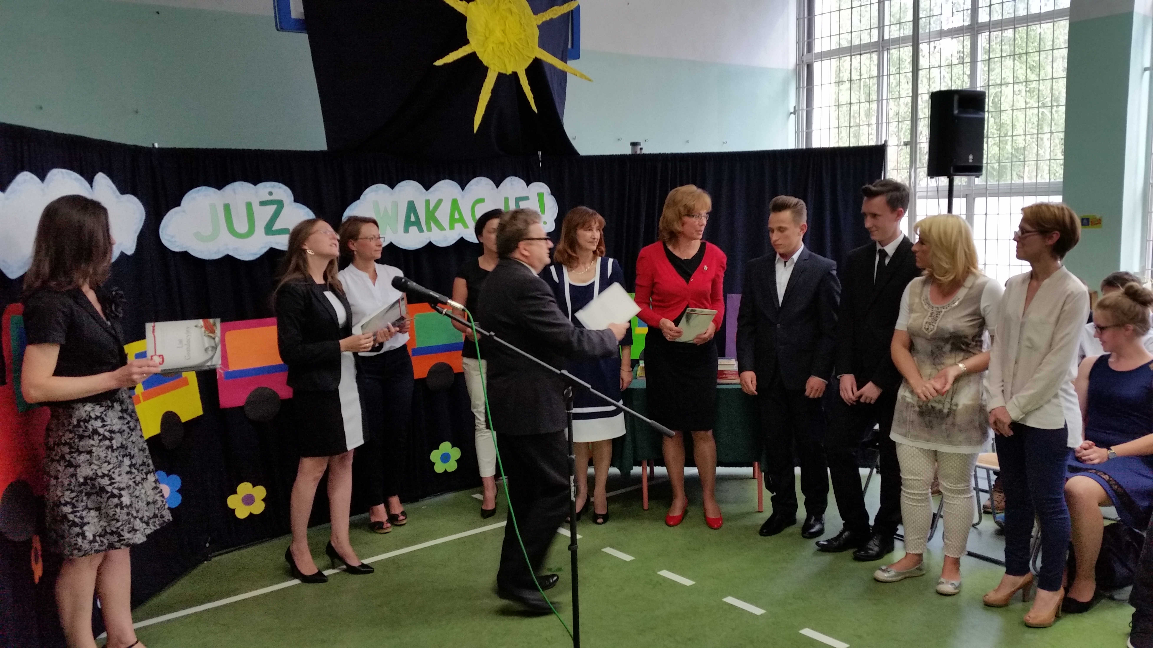
5. Co-operation with parents
Parents as the source of knowledge about their child
Common educational aims of both parents and teachers
Openness and partnership
Parents included in school community in the highest rate
Notes:
5. Co-operation with parents
Parents as the source of knowledge about their child
Common educational aims of both parents and teachers
Openness and partnership
Parents included in school community in the highest rate

Slide 10





6. Collaboration with institutes and support from other partners
School as the benefited partner in the structure of collaboration with:
state educational institutes
state institutes working for people with disabilities
charity institutions
sponsoring companies
universities
other schools
Notes:
6. Collaboration with institutes and support from other partners
School as the benefited partner in the structure of collaboration with:
state educational institutes
state institutes working for people with disabilities
charity institutions
sponsoring companies
universities
other schools

Slide 11
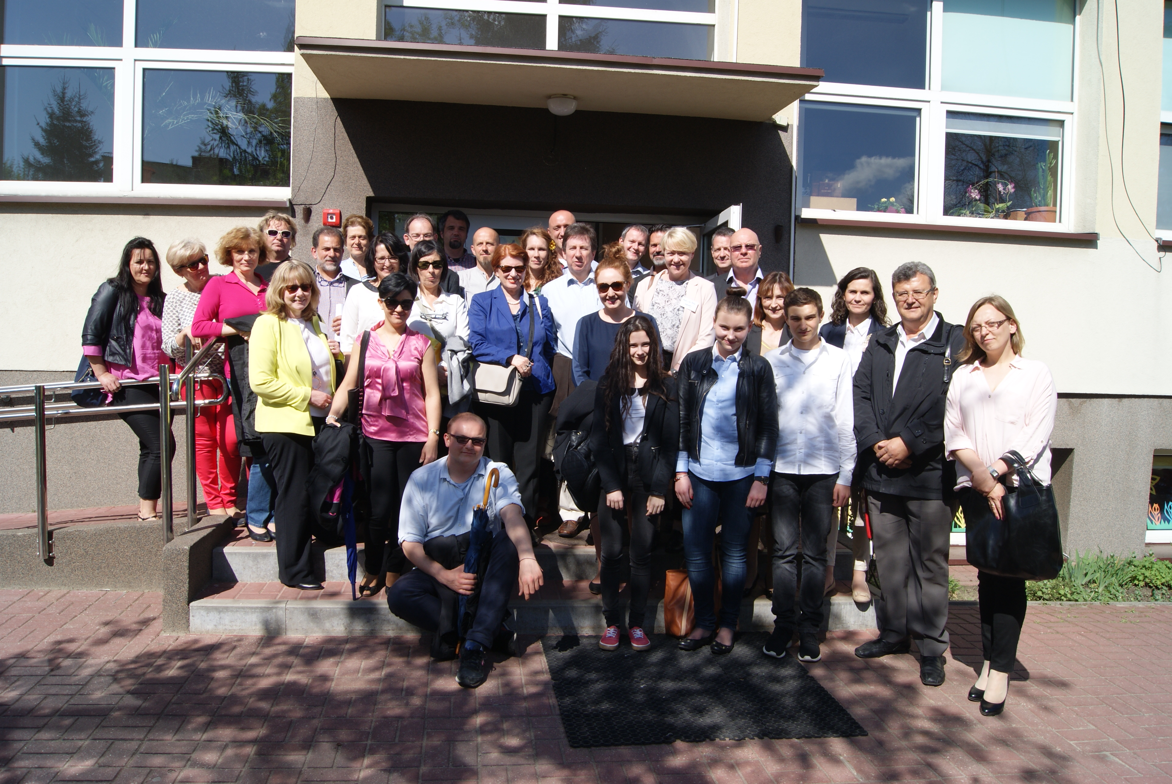
7. The school as good practice – EA project
The school in Łajski, Poland has been involved in the project since 2014 for the school-based project visits and research:
good practice as the source of knowledge and development
changes in the Polish legislation
education is an on-going process
‘Say what you do well and learn more’
‘Enjoy what you do in life’
Notes:
7. The school as good practice – EA project
The school in Łajski, Poland has been involved in the project since 2014 for the school-based project visits and research:
good practice as the source of knowledge and development
changes in the Polish legislation
education is an on-going process
‘Say what you do well and learn more’
‘Enjoy what you do in life’

Slide 12

Contact
We wish you success and good luck!
Zespół Szkół w Łajskacha
63 Kościelna Street, 05-119 Legionowo
Poland
www.splajski.edupage.org
Notes:
Contact
We wish you success and good luck!
Zespół Szkół w Łajskach
63 Kościelna Street, 05-119 Legionowo
Poland
www.splajski.edupage.org

