Slide 1
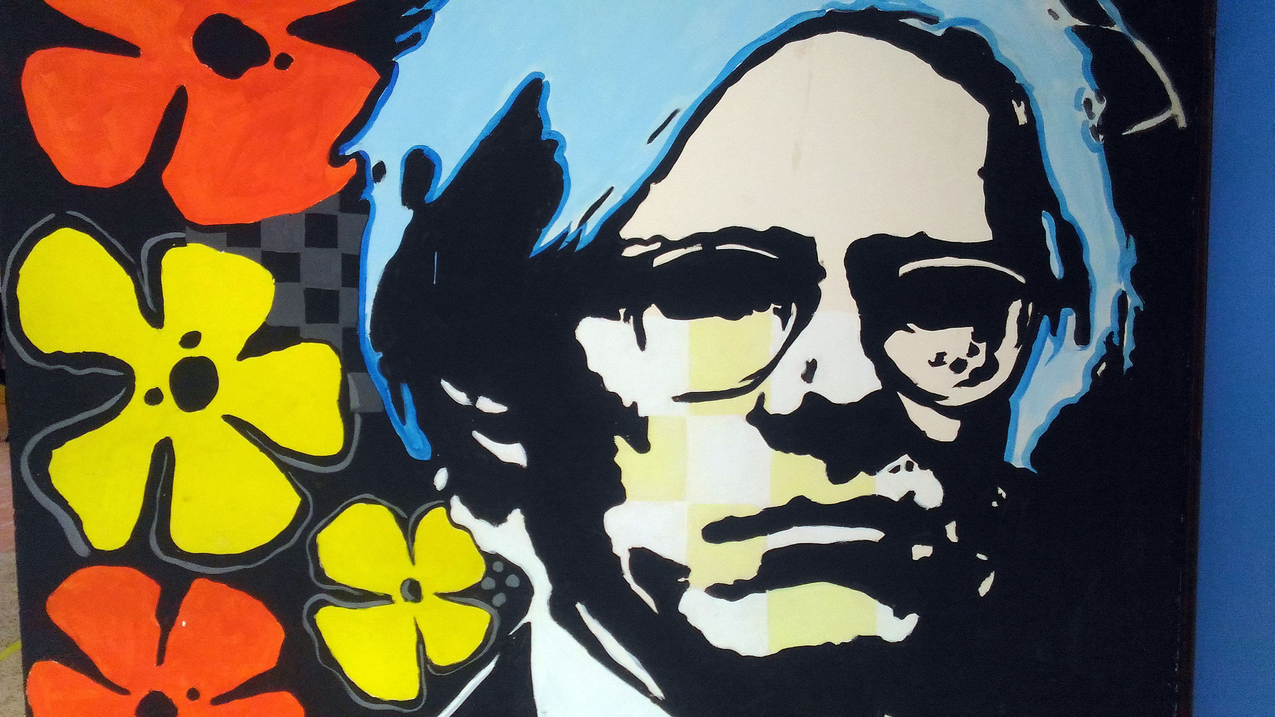


I. C. ROSMINI
5-7 APRIL 2017 @ MALTA
RAISING ACHIEVEMENT FOR ALL LEARNERS IN INCLUSIVE EDUCATION
Notes:
I. C. ROSMINI
5-7 APRIL 2017 @ MALTA
RAISING ACHIEVEMENT FOR ALL LEARNERS IN INCLUSIVE EDUCATION

Slide 2
ON PEDAGOGY
Workshop session
Notes:
ON PEDAGOGY
Workshop session

Slide 3
?
Notes:
?

Slide 4
A.
How can curricula and teaching methodologies be adapted in order to take into account the individual features of each student?
Notes:
A.
How can curricula and teaching methodologies be adapted in order to take into account the individual features of each student?

Slide 5
B.
Can we grant each of them the chance to develop their best potentialities?
Notes:
B.
Can we grant each of them the chance to develop their best potentialities?

Slide 6
C.
How can we fit teaching styles, methodologies and teaching environments to the different learning styles of the students?
Notes:
C.
How can we fit teaching styles, methodologies and teaching environments to the different learning styles of the students?

Slide 7
D.
Can all members of the class group share common goals?
Notes:
D.
Can all members of the class group share common goals?

Slide 8
THE SCHOOL INTO THE LIBRARY
case study workshop 28-30 November 2016 @ ROME
Notes:
THE SCHOOL INTO THE LIBRARY
case study workshop 28-30 November 2016 @ ROME

Slide 9
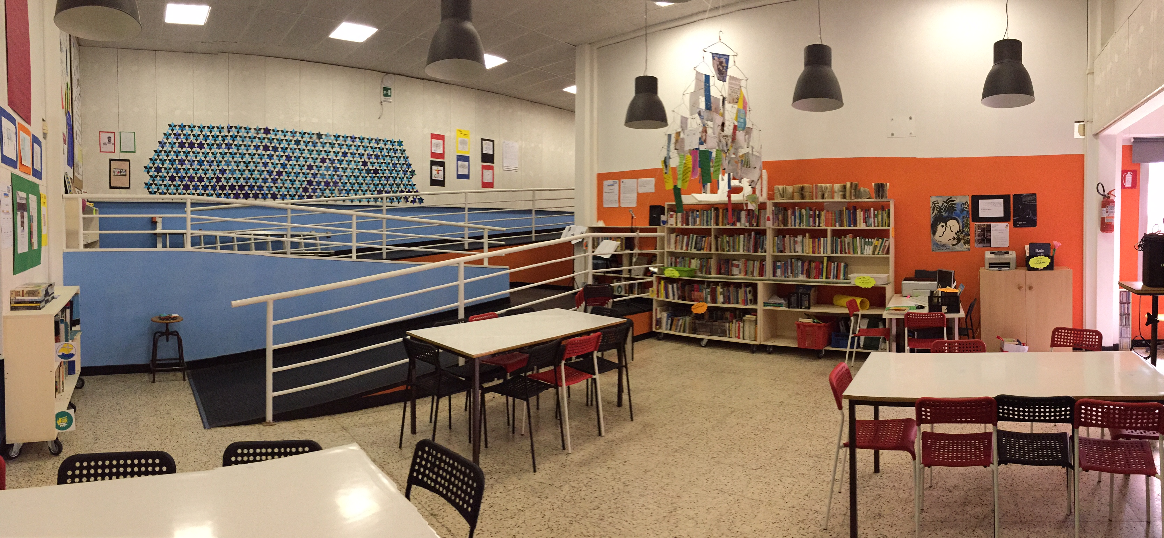
School library
Notes:
School library

Slide 10
COMMON GROUND
Notes:
COMMON GROUND

Slide 11
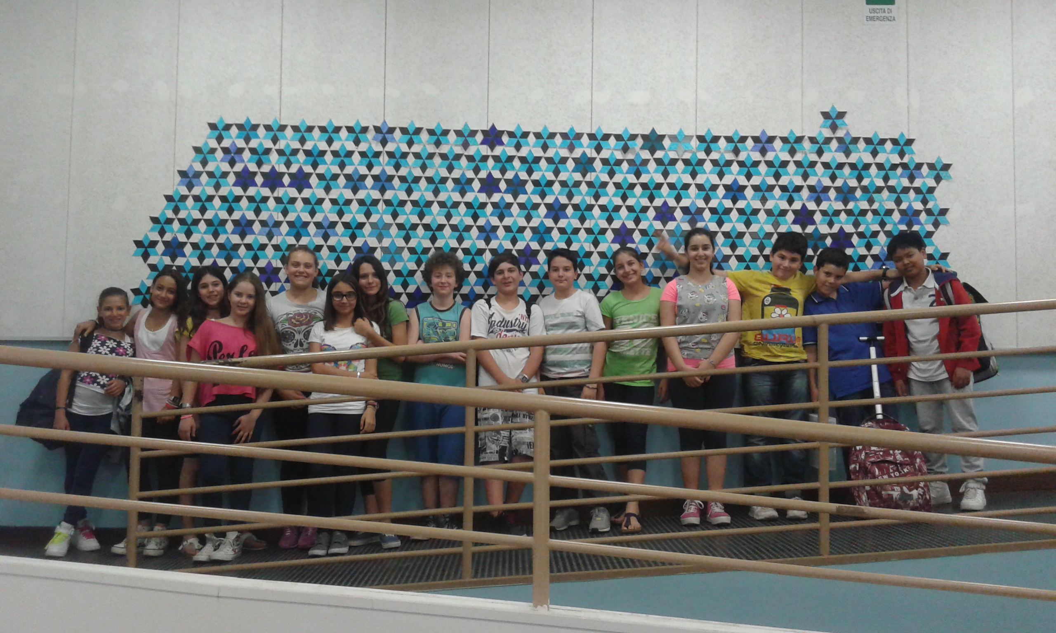
Learners in open area by the library
Notes:
Learners in open area by the library

Slide 12
A DECALOGUE
The inclusive school is where…
Notes:
A DECALOGUE
The inclusive school is where…

Slide 13
1
TEACHING
IS
LEARNING
(and the other way around)
Notes:
1
TEACHING IS LEARNING
(and the other way around)

Slide 14
2
DIFFERENCES
ARE
VALUES
Notes:
2 DIFFERENCES ARE VALUES

Slide 15
3
CROSS
DISCIPLINARY
TEACHING
is based on common themes
Notes:
3 CROSS DISCIPLINARY TEACHING
is based on common themes

Slide 16
Subjects
MATHS
LITERATURE
SPANISH
GYM
MUSIC
TECHNOLOGY
Notes:
Subjects: Maths, Literature, Spanish, Technology, Music, Gym

Slide 17
FOCUSING ON COMPETENCES
THEME 1
THEME 5
THEME 3
Theme
THEME 7
THEME 4
THEME 2
THEME 6
THEME 8
from what to how
Notes:
FOCUSING ON COMPETENCES
from what to how
Theme 1, Theme 5, Theme 4, Theme 7, Theme 2, Theme 3, Theme 6, Theme 8

Slide 18
4
COMPETITIVE VS COLLABORATIVE?
focus on competences
Notes:
4
COMPETITIVE VS COLLABORATIVE?
focus on competences

Slide 19
COMPETENCES IN ACTION
Competence 2
Competence 1
Competence 3
COMMON
PROJECT
Competence 4
Competence 6
Competence 5
…..
teacher as an architect to build a “cathedral”
Notes:
COMPETENCES IN ACTION
teacher as an architect to build a “cathedral”
Common project: Competence 1, Competence 2, Competence 3, Competence 4, Competence 5, Competence 6, …

Slide 20
5
OPENNESS AND FLEXIBILITY
challenging tasks for quick learners
Notes:
5
OPENNESS AND FLEXIBILITY
challenging tasks for quick learners

Slide 21
6
COTEACHING
disseminating, sharing, using feedback and improving
Notes:
6
COTEACHING
disseminating, sharing, using feedback and improving

Slide 22
7
EXPRESSIVE LANGUAGE
(analysis vs analogy and…. indeterminacy)
Notes:
7
EXPRESSIVE LANGUAGE
(analysis vs analogy and…. indeterminacy)

Slide 23
UNESCO Recommendation
Member States should urge educators, in collaboration with pupils, parents, the organizations concerned and the community, to use methods which appeal to the creative imagination of children and adolescents and to their social activities and thereby to prepare them to exercise their rights and freedom while respecting the rights of others and to perform their social duties.
Recommendation concerning Education for International Understanding, Co-operation and Peace and Education relating to Human Rights and Fundamental Freedoms, UNESCO adopted November 22, 1974
Notes:
UNESCO Recommendation
Member States should urge educators, in collaboration with pupils, parents, the organizations concerned and the community, to use methods which appeal to the creative imagination of children and adolescents and to their social activities and thereby to prepare them to exercise their rights and freedom while respecting the rights of others and to perform their social duties.
Recommendation concerning Education for International Understanding, Co-operation and Peace and Education relating to Human Rights and Fundamental Freedoms, UNESCO adopted November 22, 1974

Slide 24
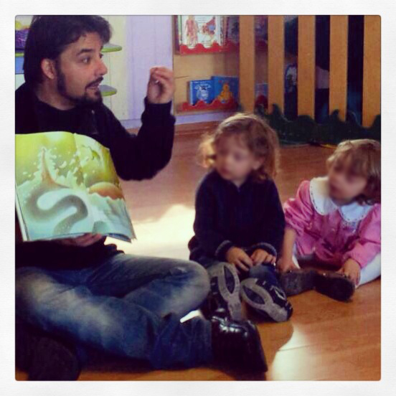
Young learners listening to the teacher who is showing a picture book
Notes:
Young learners listening to the teacher who is showing a picture book

Slide 25
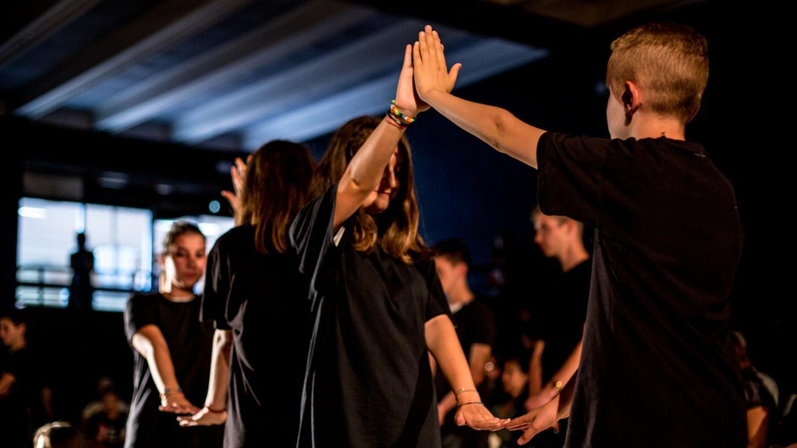
Learners working in a drama and movement session
Notes:
Learners working in a drama and movement session

Slide 26
8
UNPREDICTABILITY
Notes:
8
UNPREDICTABILITY

Slide 27
9
SPACE
design + performance + metaphor
Notes:
9
SPACE
design + performance + metaphor

Slide 28
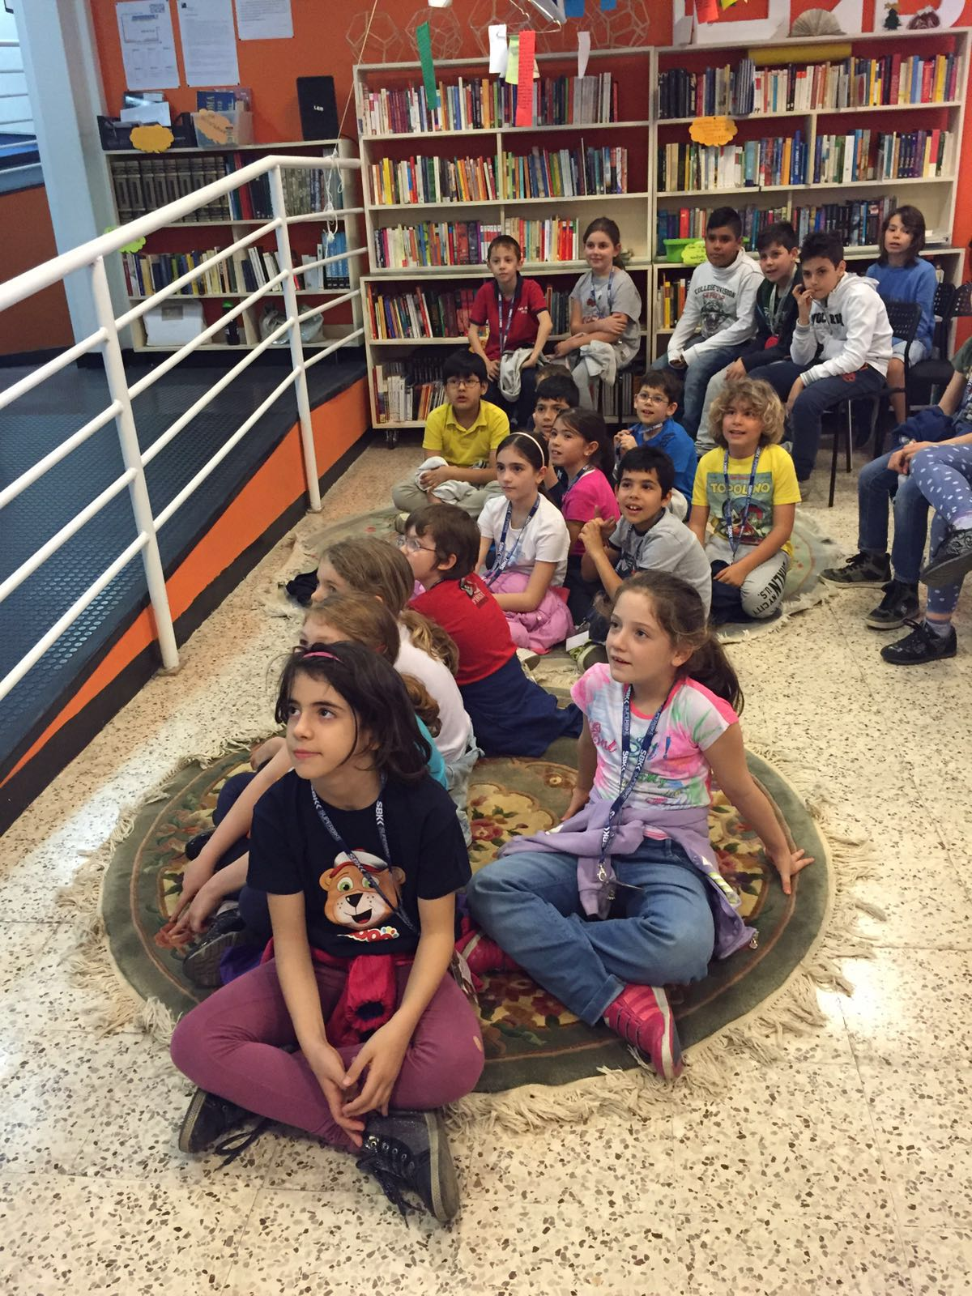
Learners using an open space in school
Notes:
Learners using an open space in school

Slide 29
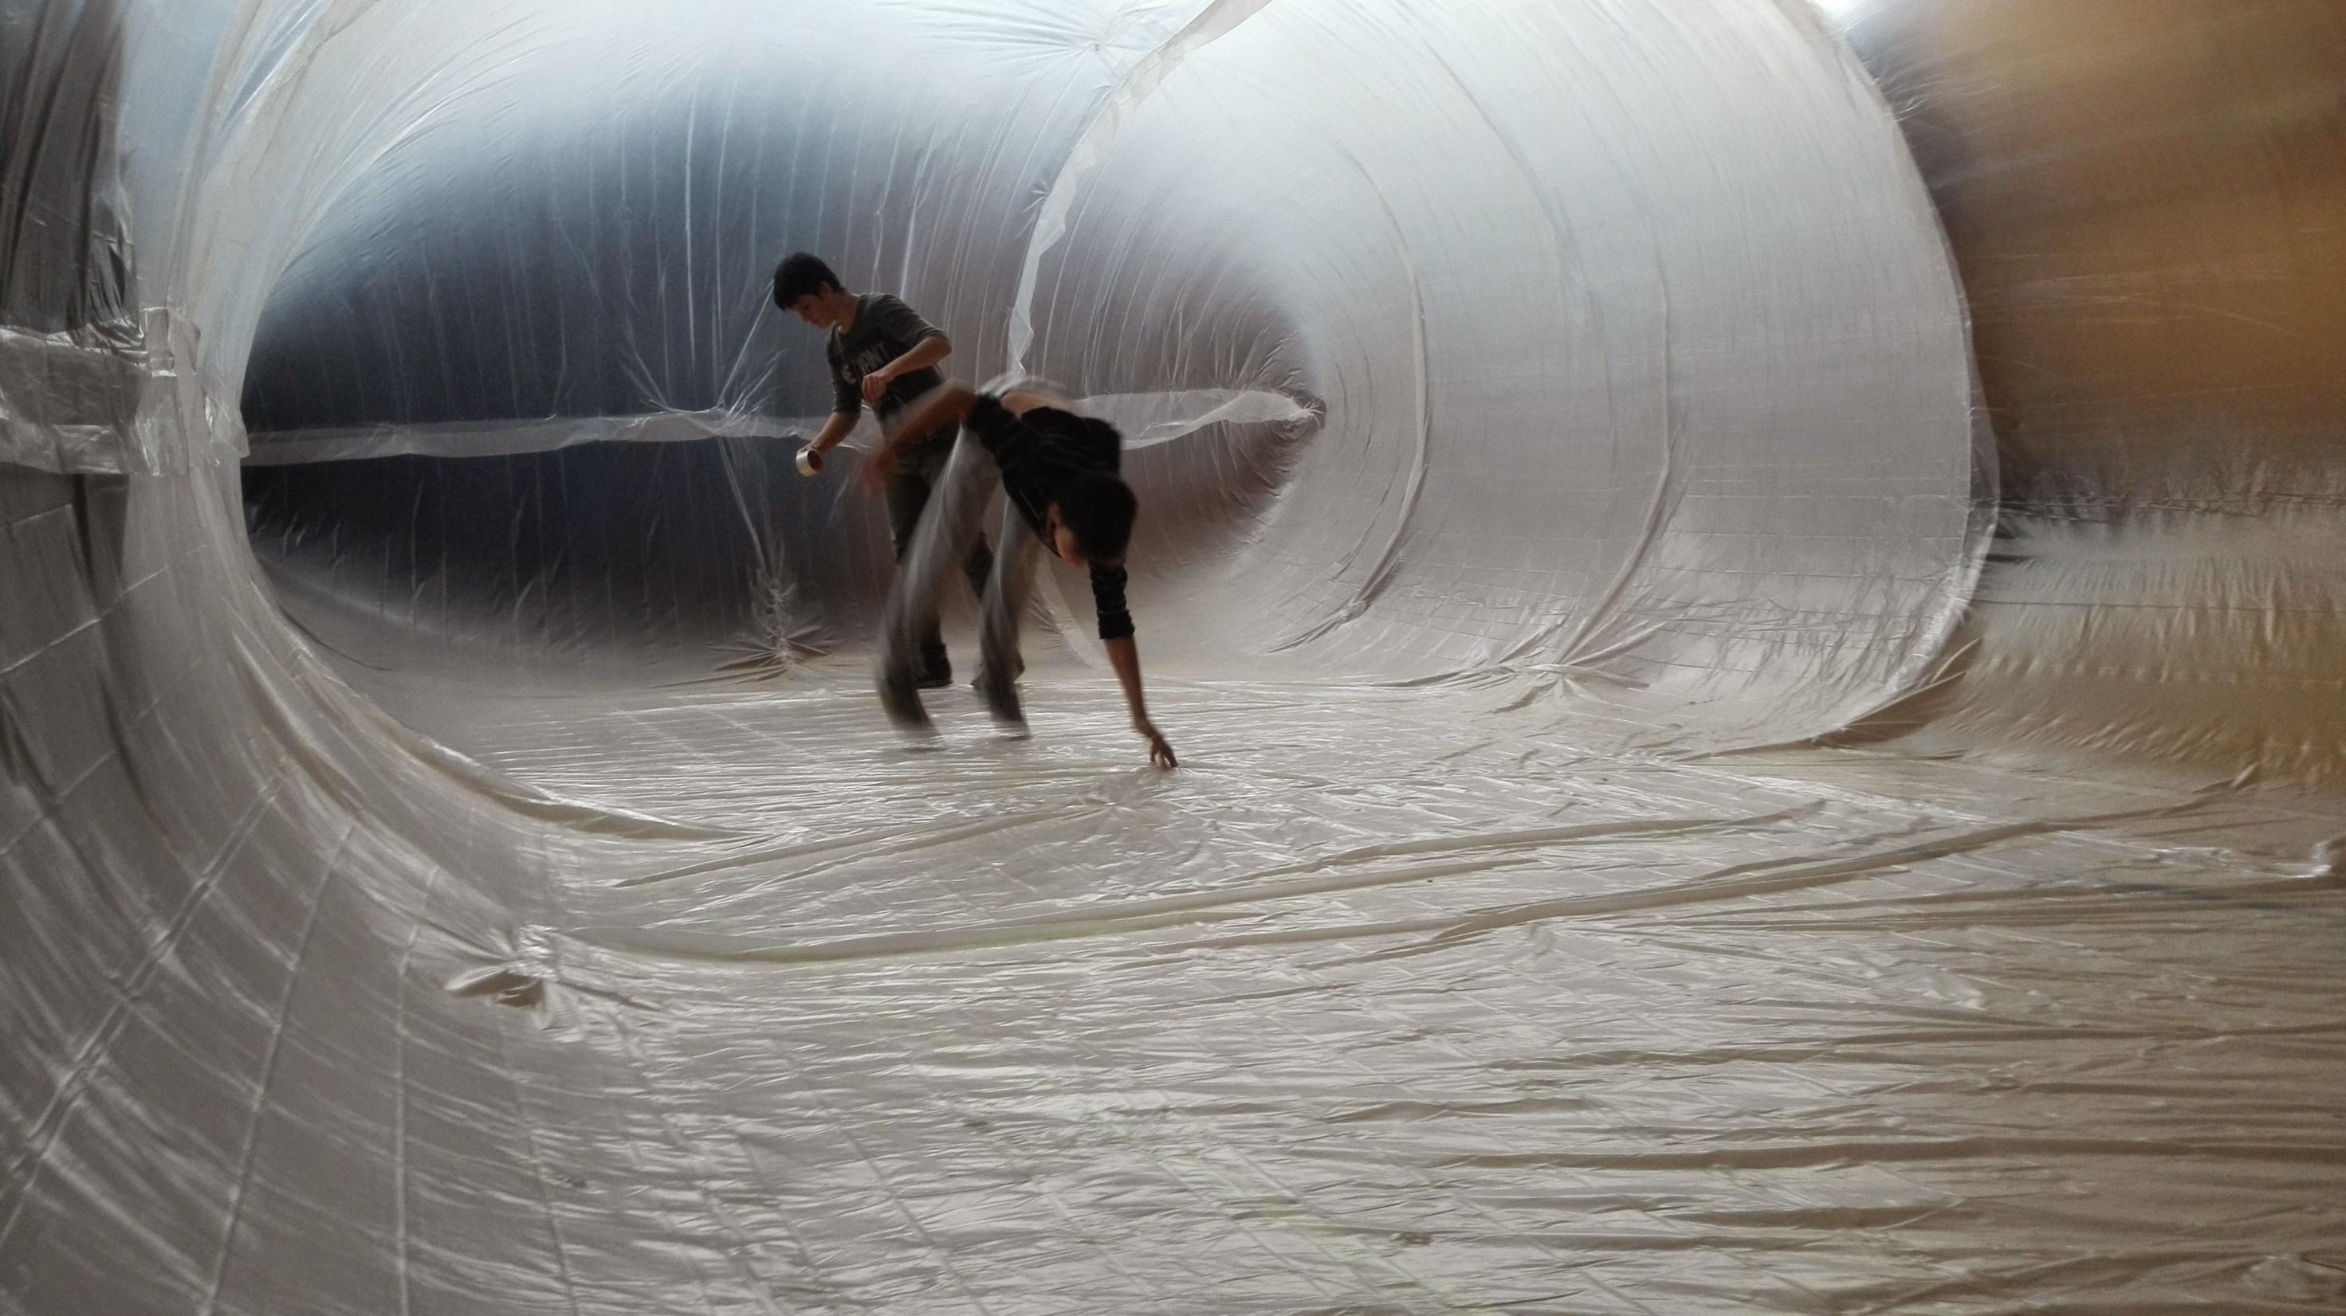
Learners working in a ‘plastic room’
Notes:
Learners working in a ‘plastic room’

Slide 30
10
ASSESSMENT:
a dialogue to improve competences
Notes:
10
ASSESSMENT:
a dialogue to improve competences

Slide 31
WHAT REMAINS IS YOU…
Strategies for an ever-changing community: like a priest for a Church
Notes:
WHAT REMAINS IS YOU…
Strategies for an ever-changing community: like a priest for a Church

Slide 32
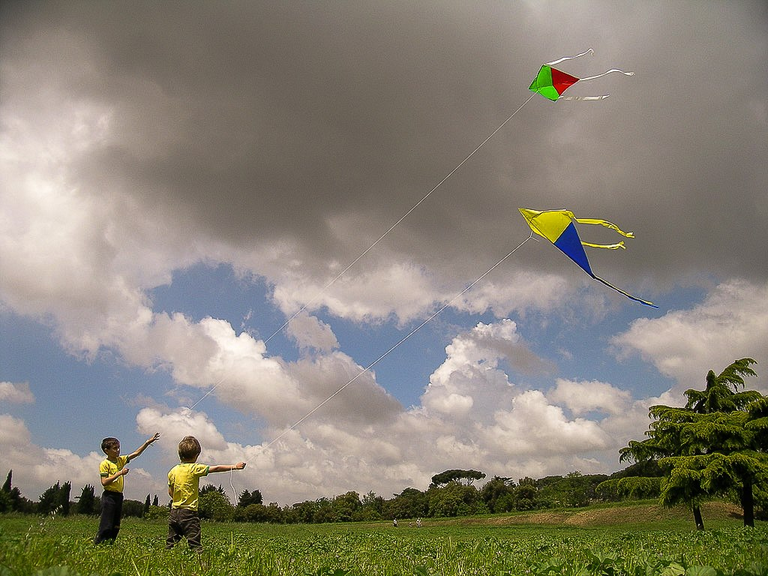
Young learners flying kites
Notes:
Young learners flying kites

Slide 33
FROM EACH ACCORDING TO HIS ABILITY, TO EACH ACCORDING TO HIS NEED
Notes:
FROM EACH ACCORDING TO HIS ABILITY, TO EACH ACCORDING TO HIS NEED

Slide 34
THANK YOU!
Workshop session
Notes:
THANK YOU!
Workshop session

