Slide 1
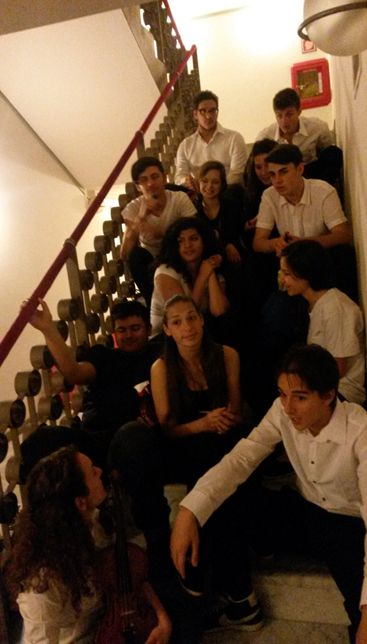
Theatre at school as inclusive practice
Mariella Demichele
Headteacher ITA Emilio Sereni, Rome
Notes:
Theatre at school as inclusive practice
Mariella Demichele
Headteacher ITA Emilio Sereni, Rome

Slide 2
I am going to expose some thoughts about the use of theatre as inclusive practice, taking into account some recent experiences in my school.
My presentation is structured as follows:
1. Brief introduction to the topic through a video
2. Methodological approaches, process and results of such theatrical practice at school
3. Questions
Notes:
I am going to expose some thoughts about the use of theatre as inclusive practice, taking into account some recent experiences in my school.
My presentation is structured as follows:
1. Brief introduction to the topic through a video
2. Methodological approaches, process and results of such theatrical practice at school
3. Questions

Slide 3
In the group:
there were students with dyspraxia, concentration disorders and ADHD syndrome;
the assistant director was a partially-sighted student with behavioural disorders.
The theatrical practice helped to activate resources, learning strategies, ways of working with a positive impact both on the artistic level and on the students’ learning.
Notes:
In the group:
there were students with dyspraxia, concentration disorders and ADHD syndrome;
the assistant director was a partially-sighted student with behavioural disorders.
The theatrical practice helped to activate resources, learning strategies, ways of working with a positive impact both on the artistic level and on the students’ learning.

Slide 4
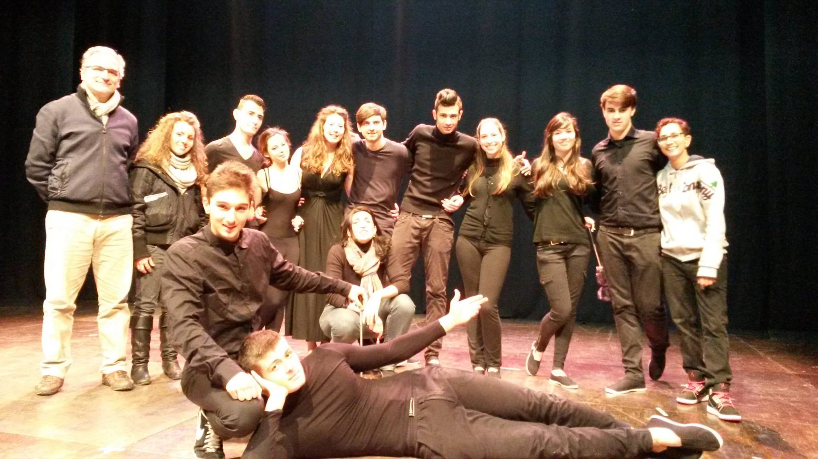
METHODOLOGICAL APPROACHES
1. ART INTEGRATION
It is an APPROACH to TEACHING in which students construct and demonstrate their UNDERSTANDING through an ART FORM. The entire process is aimed to learning.
2. DRAMA IN EDUCATION
Theatre is not another school discipline, but rather an occasion to promote a new learning environment, where theatrical techniques are used primarily as a method to activate work and study.
Notes:
METHODOLOGICAL APPROACHES
1. ART INTEGRATION
It is an APPROACH to TEACHING in which students construct and demonstrate their UNDERSTANDING through an ART FORM. The entire process is aimed to learning.
2. DRAMA IN EDUCATION
Theatre is not another school discipline, but rather an occasion to promote a new learning environment, where theatrical techniques are used primarily as a method to activate work and study.

Slide 5
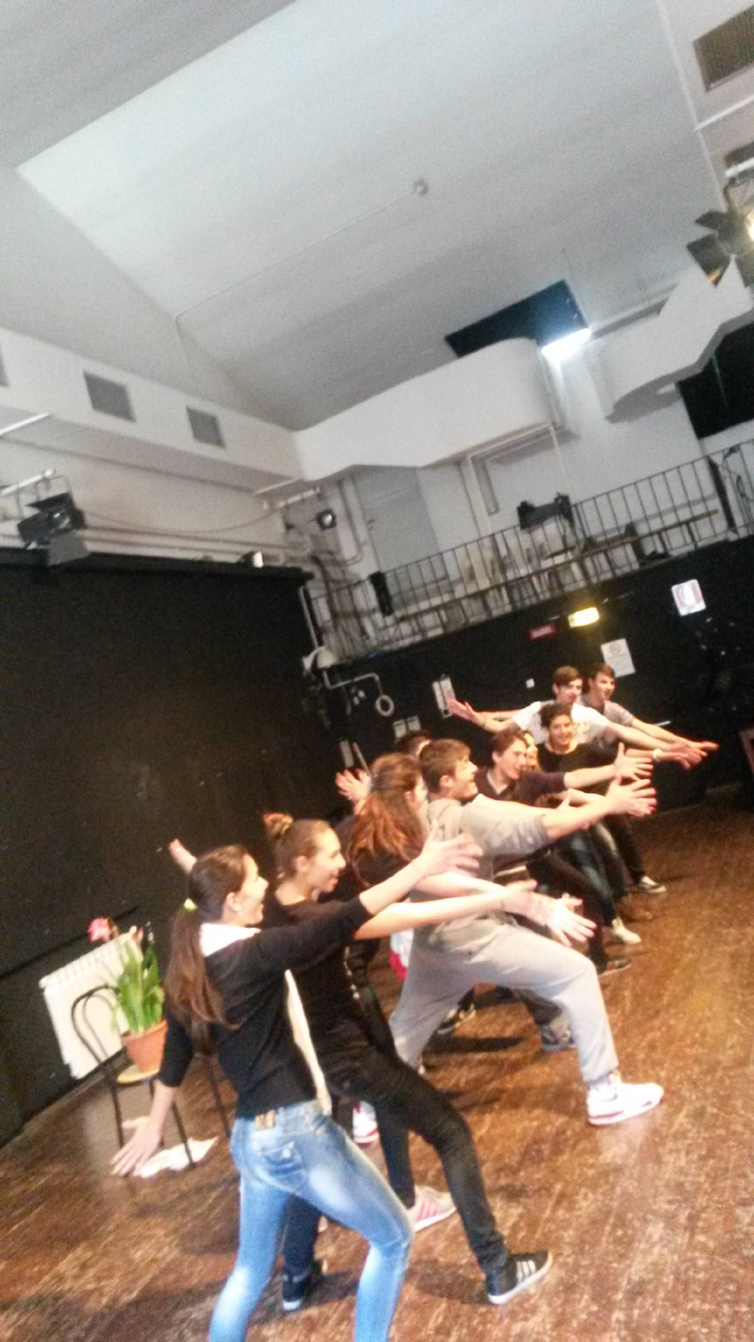
Process (1)
Theatre is an effective tool for the acquisition of knowledge and skills through the use of personal creativity and the collaboration with the group.
In the planning activity there are:
Research and writing laboratory to build the drama
Expressive laboratory through the use of body and voice
Notes:
Process (1)
Theatre is an effective tool for the acquisition of knowledge and skills through the use of personal creativity and the collaboration with the group.
In the planning activity there are:
Research and writing laboratory to build the drama
Expressive laboratory through the use of body and voice

Slide 6
1. Research and writing laboratory to build the drama
A distinguishing aspect of arts integration is its interdisciplinary connections. The subject “water” crosses easily all disciplines. In particular:
Literature: comparative reading of various stories about the Flood and aquatic divinities.
Historical and social studies: scientific articles used to reflect about the consequences of the lack of water in some parts of the world.
Notes:
1. Research and writing laboratory to build the drama
A distinguishing aspect of arts integration is its interdisciplinary connections. The subject “water” crosses easily all disciplines. In particular:
Literature: comparative reading of various stories about the Flood and aquatic divinities.
Historical and social studies: scientific articles used to reflect about the consequences of the lack of water in some parts of the world.

Slide 7
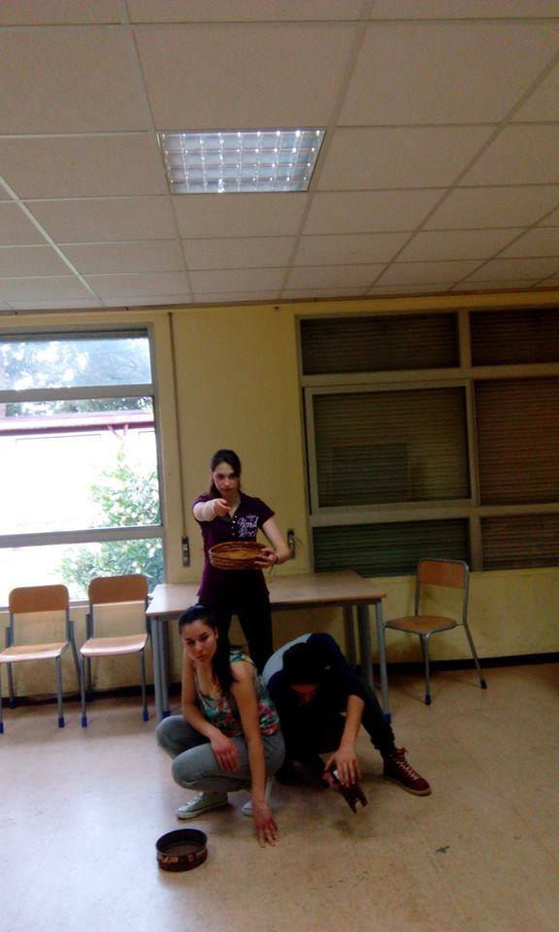
2. Expressive laboratory through the use of body and voice
Use of Grotowski’s laboratory model
It is a warm and friendly environment in which students:
are able to enhance their psycho-physical well-being
begin a process that leads them to experience both their own intimacy and external reality without fearing to be judged.
Notes:
2. Expressive laboratory through the use of body and voice
Use of Grotowski’s laboratory model
It is a warm and friendly environment in which students:
are able to enhance their psycho-physical well-being
begin a process that leads them to experience both their own intimacy and external reality without fearing to be judged.

Slide 8
Key words: relationship based on intimacy and trust
Notes:
Key words: relationship based on intimacy and trust
'Intimate or drastic elements in the work of others are untouchable and should not be commented upon even in their absence. Private conflicts, quarrels, sentiments, animosities are unavoidable in any human group. It is our duty towards creation to keep these in check in so far as they might deform and wreck the work process.' (Jerzy Grotowski).

Slide 9
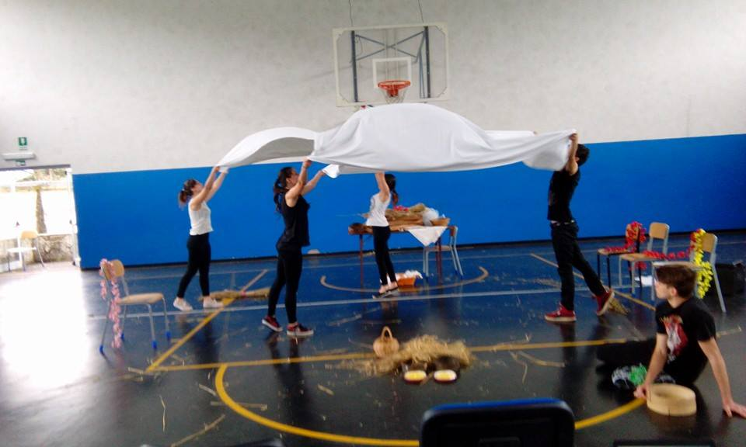
Process (2) Each lesson follows a specific pattern:
physical exercises to enhance concentration, movement control, body balance, coordination and spatial perception
expressive work through improvisation, interpretation of texts, study of gestures and voice
feedback dedicated to verbalization
Notes:
Process (2) Each lesson follows a specific pattern:
physical exercises to enhance concentration, movement control, body balance, coordination and spatial perception
expressive work through improvisation, interpretation of texts, study of gestures and voice
feedback dedicated to verbalization

Slide 10
Process (3)
Such an activity requires a particular kind of teacher who can be defined:
Liminal intellectual
Reflexive researcher
Intellectual in action
In this process, as conductor of laboratory, he must be an educator-actor who combines "the theatrical competence that stimulates the artistic abilities of the students and the specific pedagogical skills of an educator" (Oliva, 2005)
Notes:
Process (3)
Such an activity requires a particular kind of teacher who can be defined:
Liminal intellectual
Reflexive researcher
Intellectual in action
In this process, as conductor of laboratory, he must be an educator-actor who combines "the theatrical competence that stimulates the artistic abilities of the students and the specific pedagogical skills of an educator" (Oliva, 2005)

Slide 11
Results (1) Theatre has got everything!!!
It’s project based
It’s “maker” based
It encompasses all areas of learning both academic and practical/tech trades
It is a team and solo effort at the same time
It promotes deep thinking
It promotes creative thinking
It promotes critical analysis
It promotes problem solving
Notes:
Results (1) Theatre has got everything!!!
It’s project based
It’s “maker” based
It encompasses all areas of learning both academic and practical/tech trades
It is a team and solo effort at the same time
It promotes deep thinking
It promotes creative thinking
It promotes critical analysis
It promotes problem solving

Slide 12
Results (2)
The following aspects are particularly significant for students with special needs:
Development of imagination as a "constitutive element of cognitive processes“
Opportunity to explore emotions and situations, even extreme, in a protected environment
Centrality of work through body and voice
Interaction with the group and emancipation from isolation and stereotyped and rigid behaviours
Notes:
Results (2)
The following aspects are particularly significant for students with special needs:
Development of imagination as a "constitutive element of cognitive processes“
Opportunity to explore emotions and situations, even extreme, in a protected environment
Centrality of work through body and voice
Interaction with the group and emancipation from isolation and stereotyped and rigid behaviours

Slide 13
QUESTIONS
Do you use theatrical workshops for educational purposes? How?
Do teachers conduct laboratories on their own or in collaboration with external experts?
Are the laboratories integrated into the curriculum? Are students assessed?
What can be done to foster a greater participation for students with severe disabilities?
Notes:
QUESTIONS
Do you use theatrical workshops for educational purposes? How?
Do teachers conduct laboratories on their own or in collaboration with external experts?
Are the laboratories integrated into the curriculum? Are students assessed?
What can be done to foster a greater participation for students with severe disabilities?

Slide 14
References and Contact
GOUSSOT A., ANNALORO E. (2015). Risorse per l'inclusione. L'inclusione come risorsa. Palermo: G.B. Palumbo.
MUSAIO, M. (2007). Pedagogia del bello, suggestioni e percorsi educativi. Milano: Franco Angeli.
OLIVA, G. (2005). Educazione alla teatralità e formazione. Dai fondamenti del movimento creativo alla form-a-zione. Milano: LED.
RUGGERI V. (2001). L’identità in psicologia e teatro. Roma: Ed. Scientifiche Maggi
RUSTIN M. (2002). Passioni in scena. Milano: Bruno Mondadori edizioni.
SAID, E. W. (1995). Dire la verità. Gli intellettuali e il potere, Milano: Feltrinelli.
Mariella Demichele
Notes:
References and Contact
GOUSSOT A., ANNALORO E. (2015). Risorse per l'inclusione. L'inclusione come risorsa. Palermo: G.B. Palumbo.
MUSAIO, M. (2007). Pedagogia del bello, suggestioni e percorsi educativi. Milano: Franco Angeli.
OLIVA, G. (2005). Educazione alla teatralità e formazione. Dai fondamenti del movimento creativo alla form-a-zione. Milano: LED.
RUGGERI V. (2001). L’identità in psicologia e teatro. Roma: Ed. Scientifiche Maggi
RUSTIN M. (2002). Passioni in scena. Milano: Bruno Mondadori edizioni.
SAID, E. W. (1995). Dire la verità. Gli intellettuali e il potere, Milano: Feltrinelli.
Mariella Demichele

