Slide 1
Calderglen High School
Developing Scotland’s Young Workforce
Notes:
Calderglen High School
Developing Scotland’s Young Workforce

Slide 2
Five change themes Seven-year plan
By 2021
40% reduction
Top 5
Notes:
Five change themes Seven-year plan
By 2021
40% reduction
Top 5

Slide 3
Youth Unemployment
Be one of the top five performing countries in the EU for youth unemployment by reducing the youth unemployment rate to match the fifth best country in the EU by 2021
2014
19.0%
The rate of the fifth best country in the EU was 14.7%
2016
12.4%
Male 64% Female 36%
The rate of the fifth best country in the EU was 11.4%
Notes:
Youth Unemployment
Be one of the top five performing countries in the EU for youth unemployment by reducing the youth unemployment rate to match the fifth best country in the EU by 2021
2014
19.0%
The rate of the fifth best country in the EU was 14.7%
2016
12.4%
Male 64% Female 36%
The rate of the fifth best country in the EU was 11.4%

Slide 4
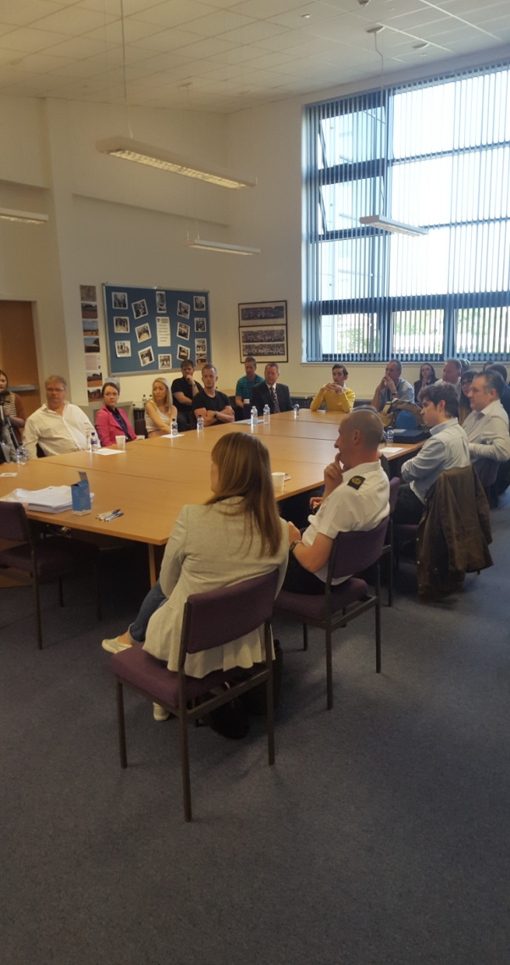
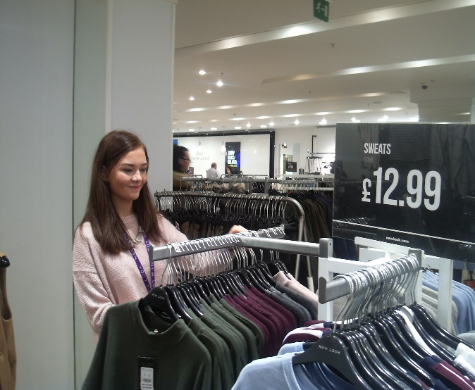
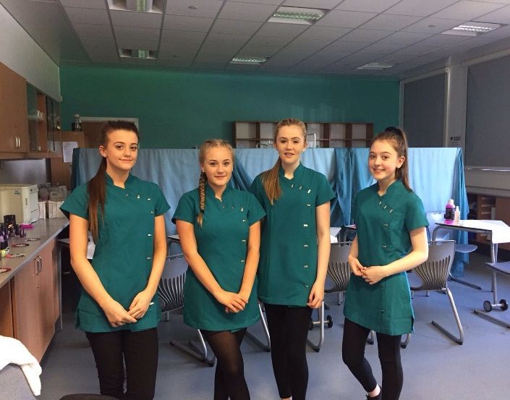
DYW at Calderglen High
Work Placements and Introduction to Work Place Skills qualification for Additional Support Needs pupils
School/Employer partnerships
Senior Phase curriculum including vocational pathways
Notes:
DYW at Calderglen High
Work Placements and Introduction to Work Place Skills qualification for Additional Support Needs pupils
School/Employer partnerships
Senior Phase curriculum including vocational pathways

Slide 5
Learning... always better in context
Notes:
Learning... always better in context
[Photo: Pairs of children lying across each other in an attempt at learning to swim on dry land, while a teacher looks on]

Slide 6
There’s more than one path to success
“... there is a widespread belief that studying for a degree will lead to a well-paid job and fulfilling professional career and whilst in many cases this is true it isn’t always the case”.
Great Expectations, City and Guilds 2015
Notes:
There’s more than one path to success
“... there is a widespread belief that studying for a degree will lead to a well-paid job and fulfilling professional career and whilst in many cases this is true it isn’t always the case”.
Great Expectations, City and Guilds 2015
68% planning to go to university. 30% number of graduate jobs

Slide 7
Foundation Apprenticeships
What are they?
Learn the skills you need for the future, while you're still at school
The difference is, you spend time away from school, at college and with an employer. So you get real, practical work experience.
Pilot – Engineering Foundation Apprenticeship
Notes:
Foundation Apprenticeships
What are they?
Learn the skills you need for the future, while you're still at school
The difference is, you spend time away from school, at college and with an employer. So you get real, practical work experience.
Pilot – Engineering Foundation Apprenticeship

Slide 8
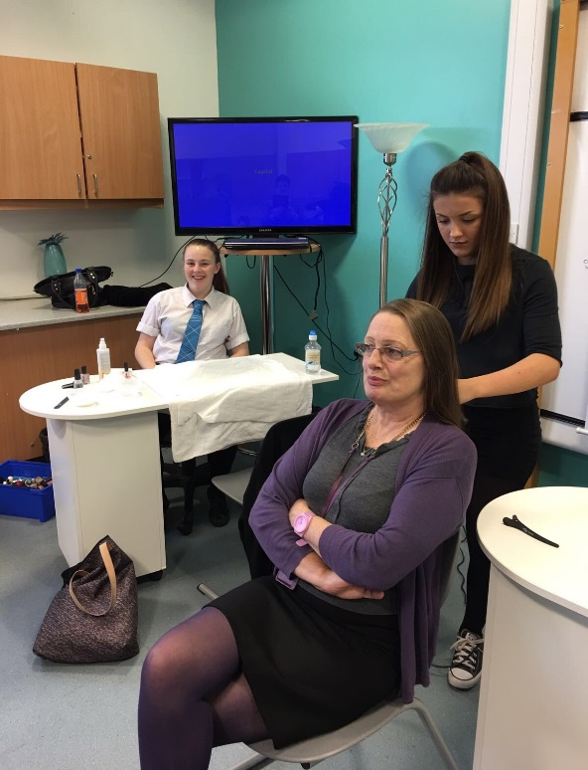
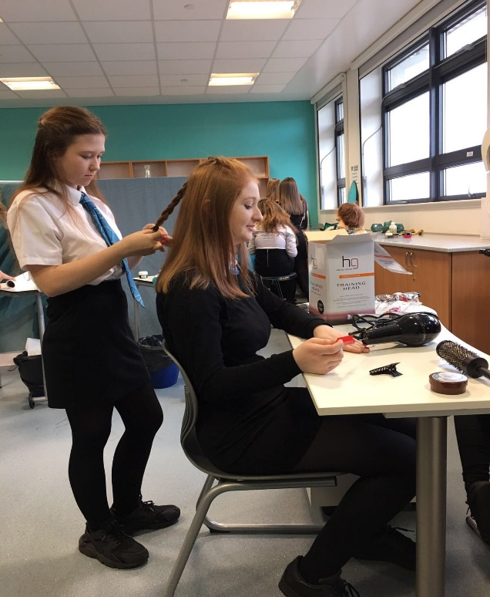
DYW in action… Hairdressing
Impact
Improved attendance
Improved record of behaviour
Improved attitude
Improved learners
Notes:
DYW in action… Hairdressing
Impact
Improved attendance
Improved record of behaviour
Improved attitude
Improved learners

Slide 9
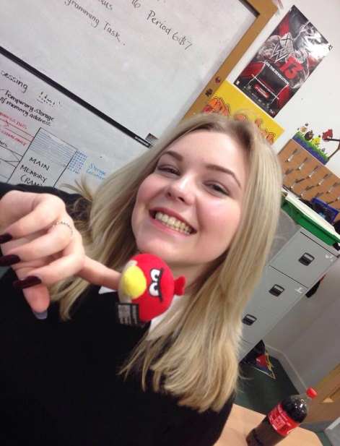
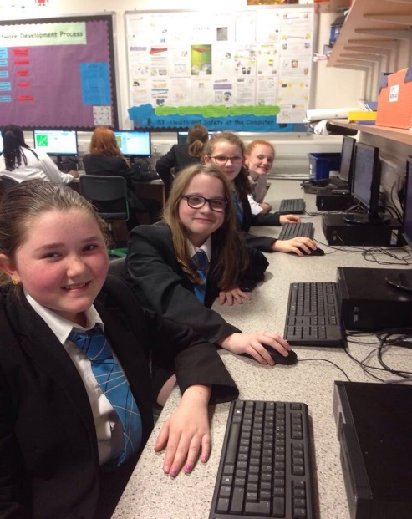
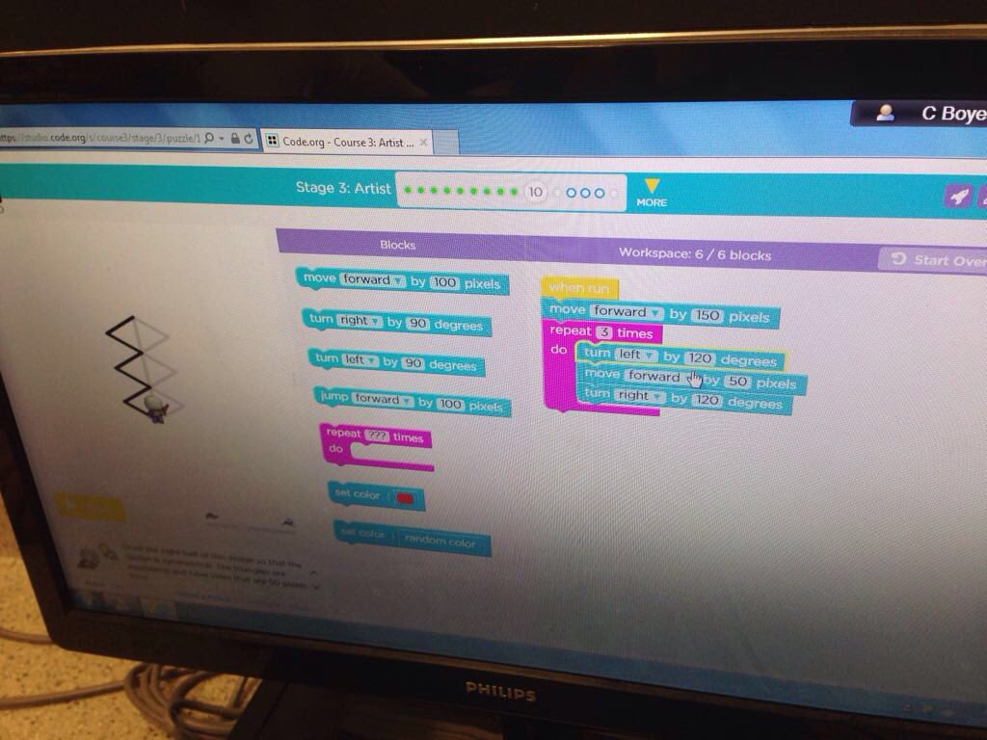
DYW in action… Girls’ coding club
Impact
Awareness of careers in digital technology for girls.
Hoping to see an increase the uptake of girls studying Computer Science.
Challenging equality in STEM related areas.
Notes:
DYW in action… Girls’ coding club
Impact
Awareness of careers in digital technology for girls.
Hoping to see an increase the uptake of girls studying Computer Science.
Challenging equality in STEM related areas.

Slide 10
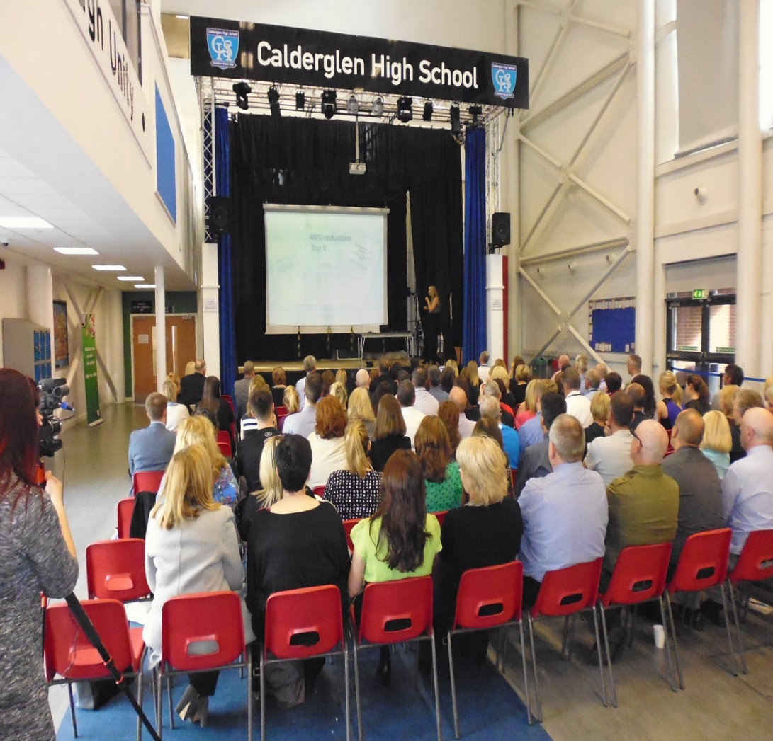
DYW in action… Staff professional development
Impact
89% of staff feel more confident about giving career advice within their subject area.
Staff have more of an understanding about Modern Apprenticeships and are now promoting them with pupils.
Staff are familiar with current labour market information and growth industries and are using this information in curricular areas.
Notes:
DYW in action… Staff professional development
Impact
89% of staff feel more confident about giving career advice within their subject area.
Staff have more of an understanding about Modern Apprenticeships and are now promoting them with pupils.
Staff are familiar with current labour market information and growth industries and are using this information in curricular areas.

Slide 11
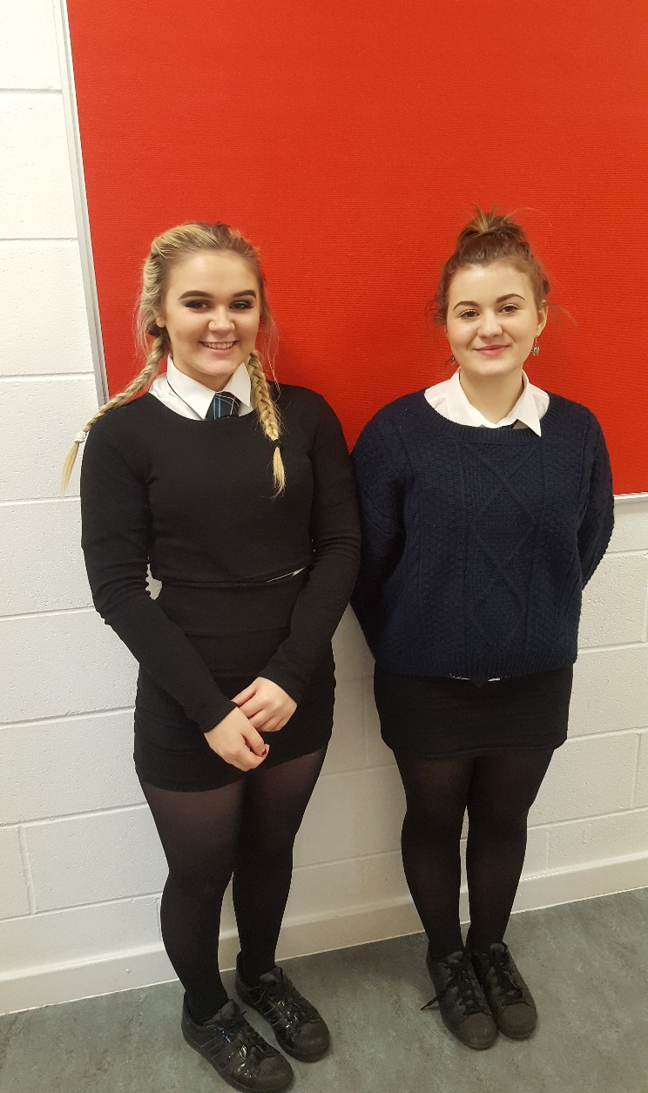
DYW in action… College partnerships
Media Make-Up course delivered by South Lanarkshire College on a Thursday 12.30pm – 6.30pm
Impact
Confirmed career choices – Contributes to other subjects, in particular Art and Photography.
Increased motivation in school – Now attend supported study to catch up on the work missed while at the course.
Girls know what qualifications they need for College courses and make it a target.
Notes:
DYW in action… College partnerships
Media Make-Up course delivered by South Lanarkshire College on a Thursday 12.30pm – 6.30pm
Impact
Confirmed career choices – Contributes to other subjects, in particular Art and Photography.
Increased motivation in school – Now attend supported study to catch up on the work missed while at the course.
Girls know what qualifications they need for College courses and make it a target.

Slide 12
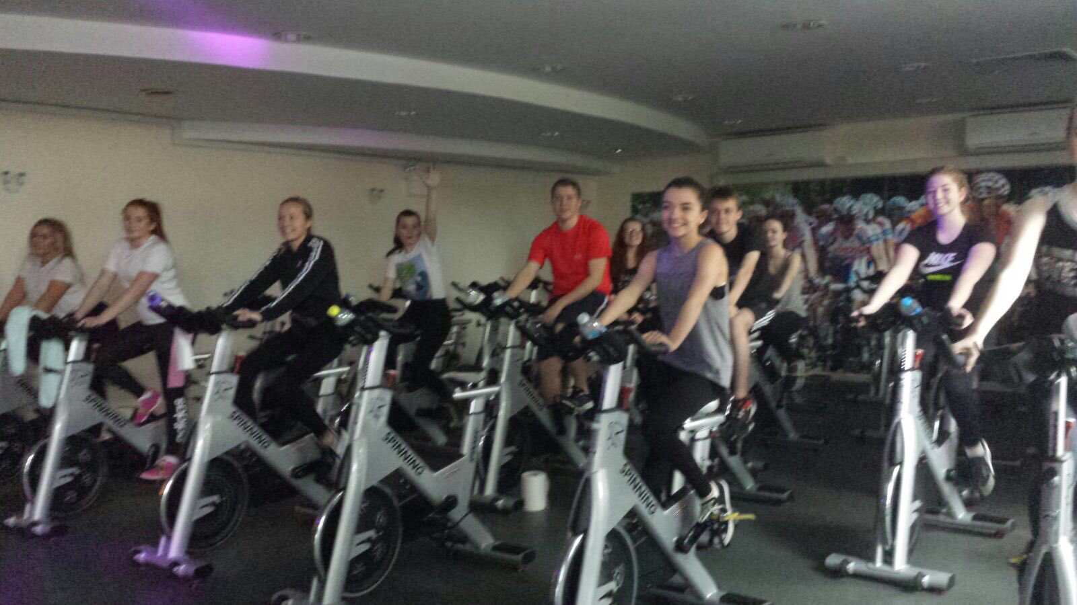
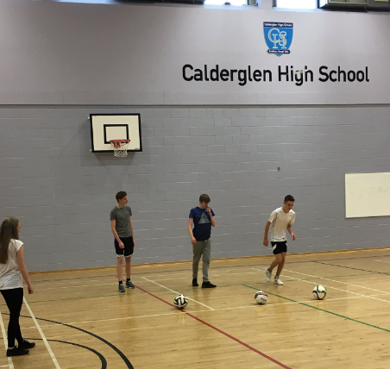
DYW in action... Community Sports Leader
Impact
Increased confidence
Improved behaviour
Leadership skills
Transferable skills
Notes:
DYW in action... Community Sports Leader
Impact
Increased confidence
Improved behaviour
Leadership skills
Transferable skills

Slide 13
Growth industries
energy
STEM
FINANCIAL & BUSINESS SERVICES
Care Services
DIGITAL WORLD
LIFE SCIENCES
Food & Drink
RETAIL
Notes:
Growth industries
STEM, energy, financial and business services, care services, digital world, life sciences, food and drink, retail

Slide 14
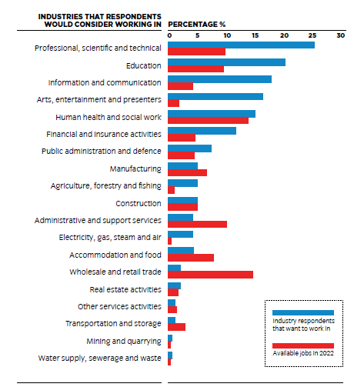
Aspirations vs Reality
“....the jobs most frequently chosen are ones that young people would commonly be exposed to (ie: secondary school teacher, police officer, doctor) or ones that they may have seen in media representations.”
Great Expectations, City and Guilds 2015
How do we collectively ensure young people are more aware of the realities of the future job market?
Notes:
Aspirations vs Reality
“....the jobs most frequently chosen are ones that young people would commonly be exposed to (ie: secondary school teacher, police officer, doctor) or ones that they may have seen in media representations.”
Great Expectations, City and Guilds 2015
How do we collectively ensure young people are more aware of the realities of the future job market?
[Bar chart: Professional, scientific and technical jobs have 25% respondents that want to work in the industry and 10% available jobs.
Education has 20% respondents and 10% available jobs.
Information and communication has 18% respondents and 5% available jobs.
Arts, entertainment and presenters has 17% respondents and 3% jobs.
Human health and social work has 15% respondents and 14% jobs.
Financial and insurance activities has 13% respondents and 5% jobs.
Public administration and defence has 9% respondents and 5% jobs.
Manufacturing has 6% respondents and 8% jobs.
Agriculture, forestry and fishing has 6% respondents and 2% jobs.
Construction has 5% respondents and jobs.
Administrative and support services has 4% respondents and 12% jobs.
Electricity, gas, steam and air has 4% respondents and 1% jobs.
Accommodation and food has 4% respondents and 8% jobs.
Wholesale and retail trade has 3% respondents and 15% jobs.
Real estate activities has 3% respondents and 2% jobs.
Other service activities has 2% respondents and 3% jobs.
Transportation and storage has 2% respondents and 4% jobs.
Mining and quarrying has 1% respondents and 0.5% jobs.
Water supply, sewerage and waste has 1% respondents and 0.5% jobs].

