Slide 1

COLLABORATION: HOW MANY WAYS?
Experiences and questions from Agricultural Technical Institute Emilio Sereni – Rome, Italy
Erika Casolino – Ph.D., Sports and Support teacher
Notes:
1
COLLABORATION: HOW MANY WAYS?
Experiences and questions from Agricultural Technical Institute Emilio Sereni – Rome, Italy
Erika Casolino – Ph.D., Sports and Support teacher

Slide 2


WHERE ARE WE MOVING THROUGH?
Pedagogy
Leadership
Collaboration – Department for Inclusion
2. Schools and families, examples of positive relations
1. Monitoring of activities and results achieved
Notes:
2
WHERE ARE WE MOVING THROUGH?
Pedagogy
Leadership
Collaboration – Department for Inclusion
Monitoring of activities and results achieved
Schools and families, examples of positive relations

Slide 3

WHO ARE THE ACTORS?
Students
Headmaster
Teachers
Parents
Support assistants
Others (Professionals, institutions, associations…)
BUT… WHERE CAN THEY MEET AND COLLABORATE?
Notes:
WHO ARE THE ACTORS?
Students
Headmaster
Teachers
Parents
Support assistants
Others (Professionals, institutions, associations…)
BUT… WHERE CAN THEY MEET AND COLLABORATE?

Slide 4
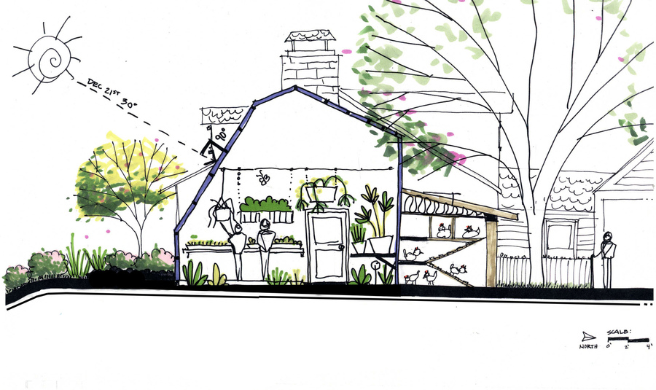
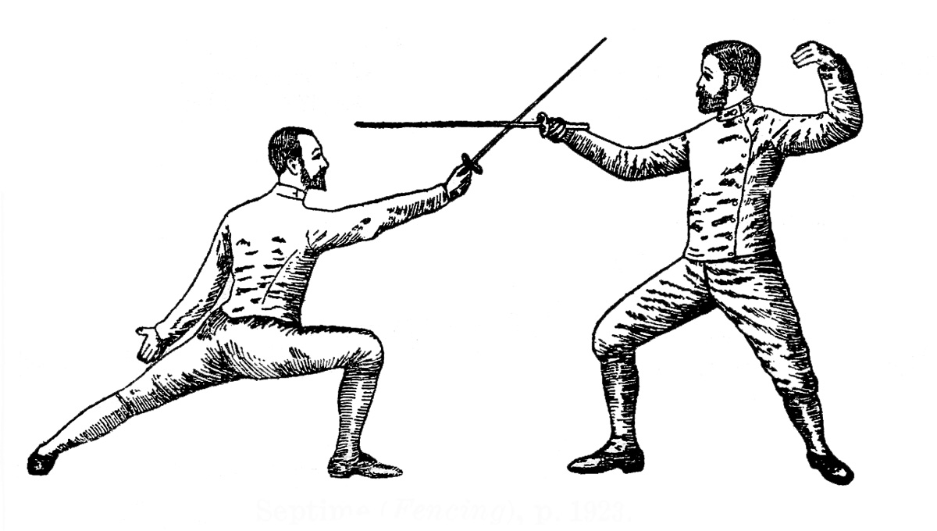
THEY CAN MEET...
(SOME EXAMPLES OF ACTIVITIES)
INSIDE THE SCHOOL:
Fencing with no limits - Sports for inclusion
Counselling point
Autism training course
OUTSIDE THE SCHOOL:
Work-related learning
Notes:
THEY CAN MEET...
(SOME EXAMPLES OF ACTIVITIES)
INSIDE THE SCHOOL:
Fencing with no limits - Sports for inclusion
Counselling point
Autism training course
OUTSIDE THE SCHOOL:
Work-related learning

Slide 5
FENCING WITH NO LIMITS
- It is a project organized by Accademia d'Armi Musumeci Greco and supported by CIP (Italian Paralympics Committee)
- Accademia d'Armi Musumeci Greco is an historical Italian fencing Academy, founded in the 1878
- It is an example of collaboration among school, the community and the territory
It promotes collaboration among teachers and students
It’s a bridge between school life and external life
It is a way to involve parents
Notes:
FENCING WITH NO LIMITS
- It is a project organized by Accademia d'Armi Musumeci Greco and supported by CIP (Italian Paralympics Committee)
- Accademia d'Armi Musumeci Greco is an historical Italian fencing Academy, founded in the 1878
- It is an example of collaboration among school, the community and the territory
It promotes collaboration among teachers and students
It’s a bridge between school life and external life
It is a way to involve parents

Slide 6
WORK-RELATED LEARNING
- It is students’ first approach to a working experience connected to school learning programs
- It is meant to make students acquire skills and competences through a practical experience
- It is another example of collaboration among school, the community and the territory
It promotes collaboration among teachers, students and school collaborators
It’s a bridge between school life and external life
It is a way to involve parents
Notes:
WORK-RELATED LEARNING
- It is students’ first approach to a working experience connected to school learning programs
- It is meant to make students acquire skills and competences through a practical experience
- It is another example of collaboration among school, the community and the territory
It promotes collaboration among teachers, students and school collaborators
It’s a bridge between school life and external life
It is a way to involve parents

Slide 7

RESULTS (1)
Fencing with no limits:
It improved collaboration among teachers, to define and organize activities
Also, head teacher and teachers involved in the project collaborated with the staff of the Academy improving the potential of the project (i.e. proposal for a school fencing tournament)
Parents involvement in a school activity (i.e. course enrolment, awareness of the project and its aims, direct connection with the Academy)
Notes:
RESULTS (1)
Fencing with no limits:
It improved collaboration among teachers, to define and organize activities
Also, head teacher and teachers involved in the project collaborated with the staff of the Academy improving the potential of the project (i.e. proposal for a school fencing tournament)
Parents involvement in a school activity (i.e. course enrolment, awareness of the project and its aims, direct connection with the Academy)

Slide 8
RESULTS (2)
Work related learning:
It stimulates collaboration among teachers and specialized school staff, to define and organize activities
Also, head teacher, teachers responsible for the area and students connect to external companies
Parents are involved in a school activity (i.e. direct connection with companies)
Notes:
RESULTS (2)
Work related learning:
It stimulates collaboration among teachers and specialized school staff, to define and organize activities
Also, head teacher, teachers responsible for the area and students connect to external companies
Parents are involved in a school activity (i.e. direct connection with companies)

Slide 9

QUESTIONS
How to make more students (and families) involved in the project? How to raise participation?
Would it be helpful to promote parents’ feedback exchange to improve the quality of this learning experience? (i.e. which company to go in?) How to do it?
Notes:
QUESTIONS
How to make more students (and families) involved in the project? How to raise participation?
Would it be helpful to promote parents’ feedback exchange to improve the quality of this learning experience? (i.e. which company to go in?) How to do it?

Slide 10
THANK YOU!
Notes:
10
THANK YOU!

Slide 11

Contact
Erika Casolino
Notes:
11
Contact
Erika Casolino

